Slide 1
Sample Pipeline 2
Azure Blob Storage → Power Query → Azure SQL Database

Slide 2
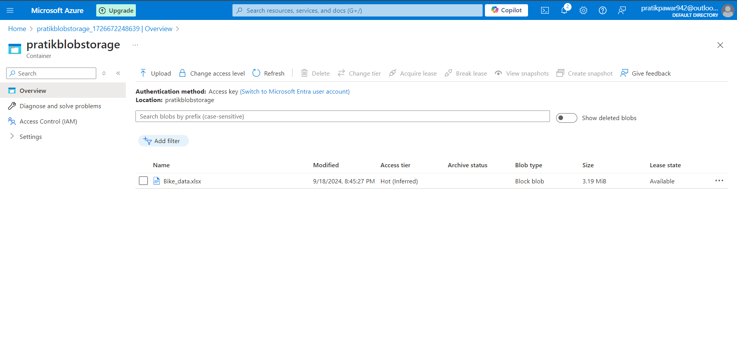
First Create Azure Blob Storage Account and Upload Files

Slide 3
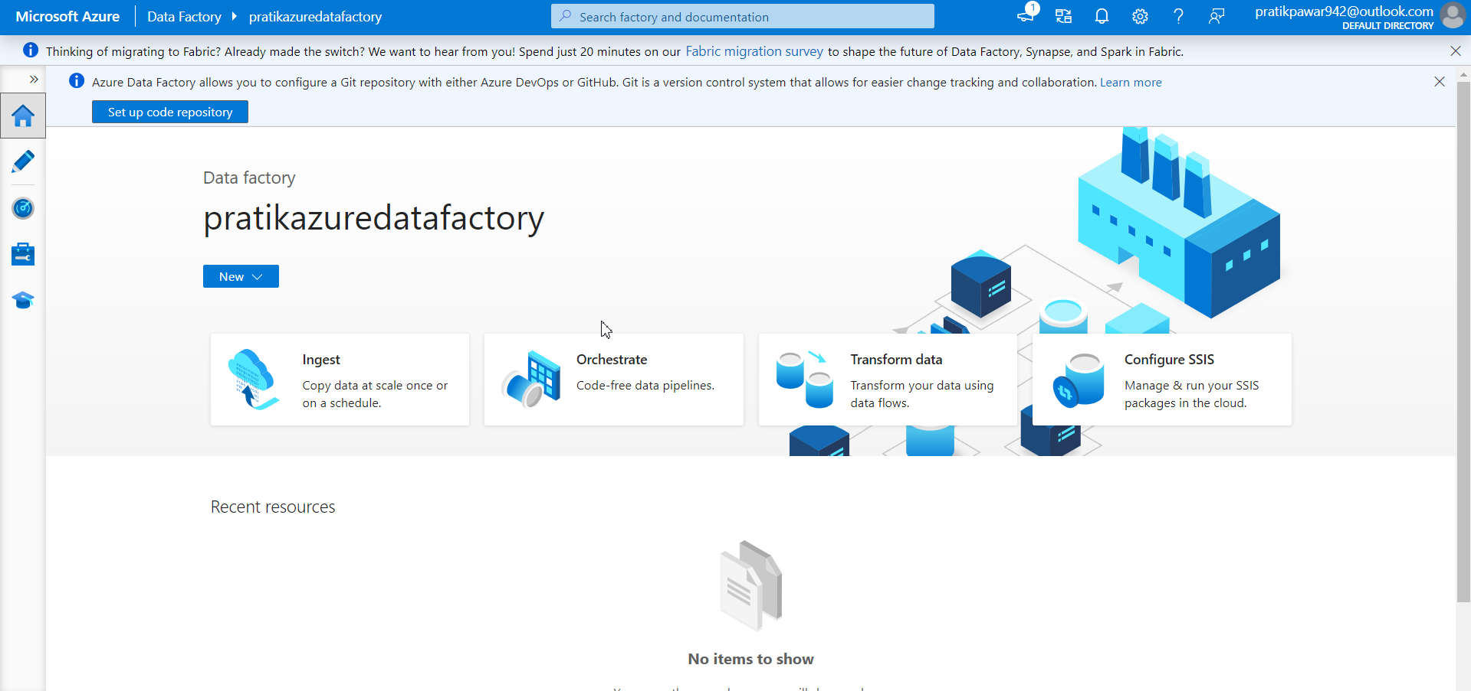
Now Create ADF for Transformation

Slide 4
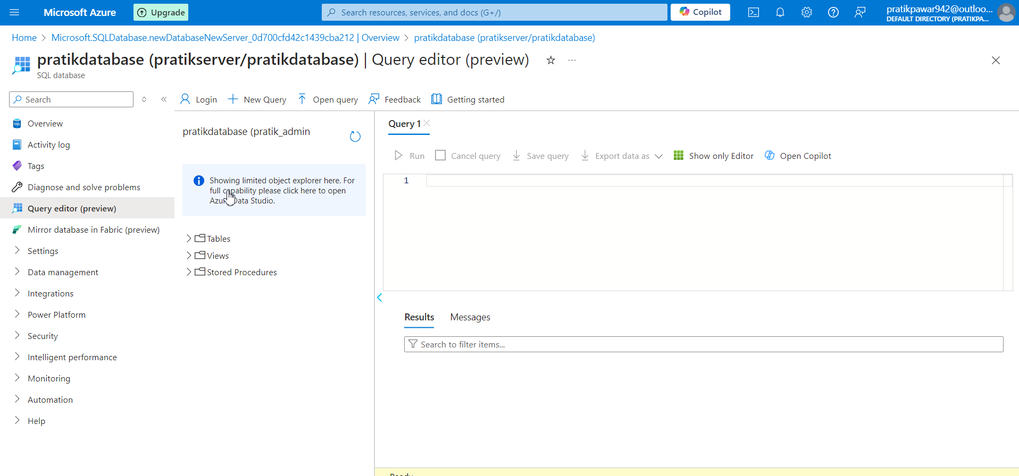
Create SQL Database

Slide 5
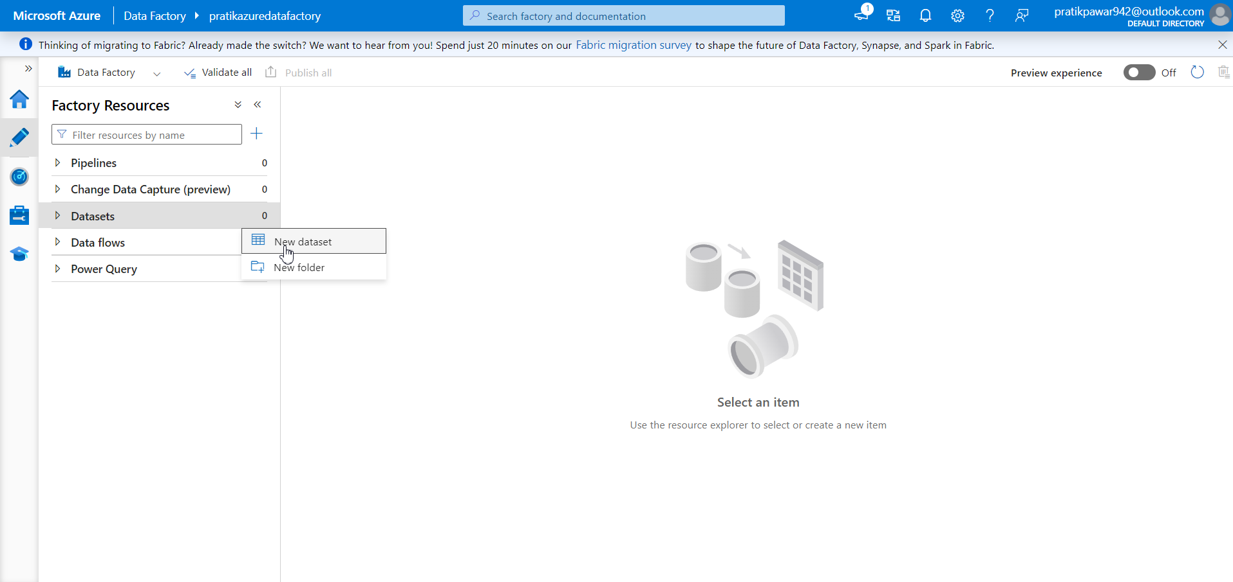
Import Required Raw Data in dataset

Slide 6
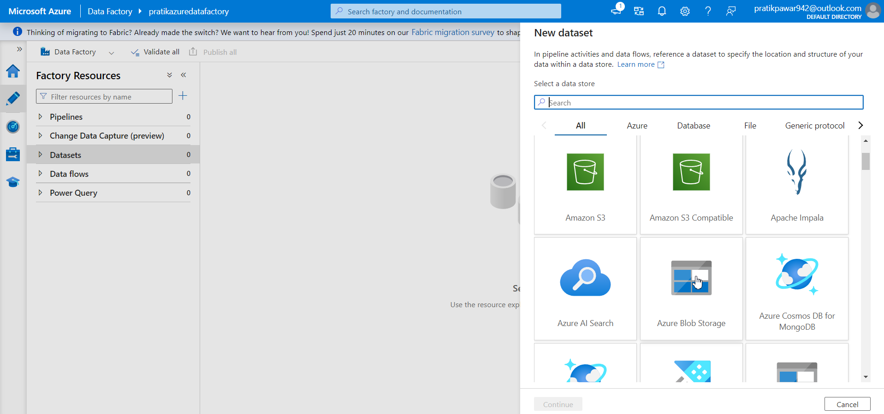
Azure Blob Storage

Slide 7
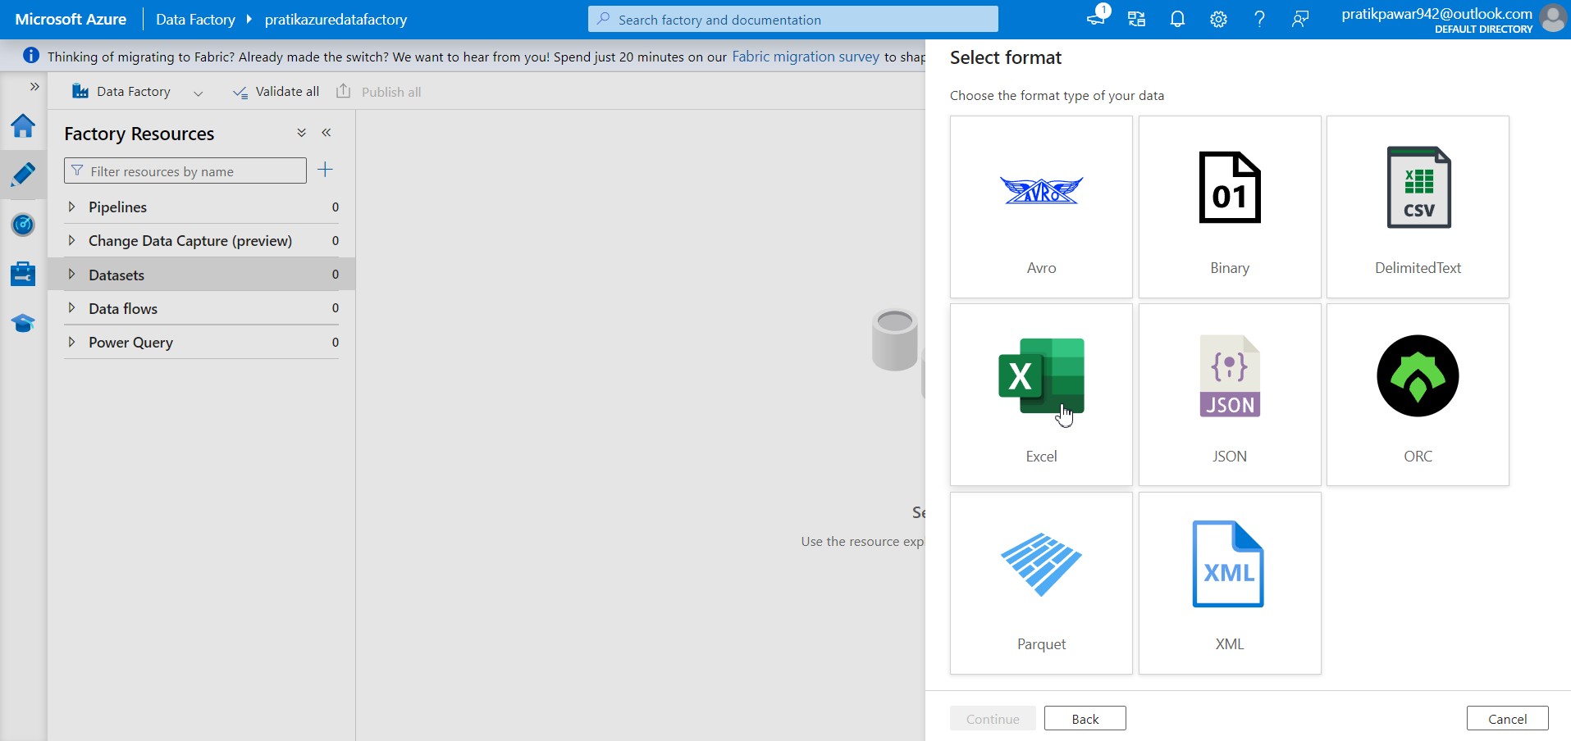
Format

Slide 8
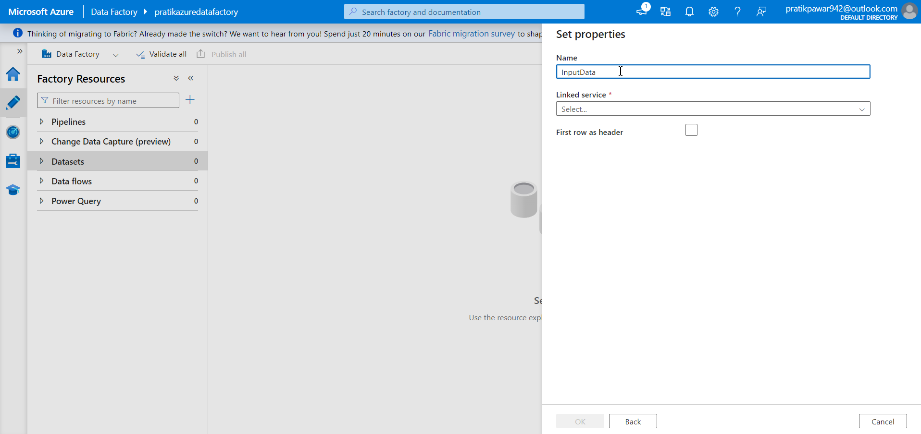
Give Name = Input Data

Slide 9
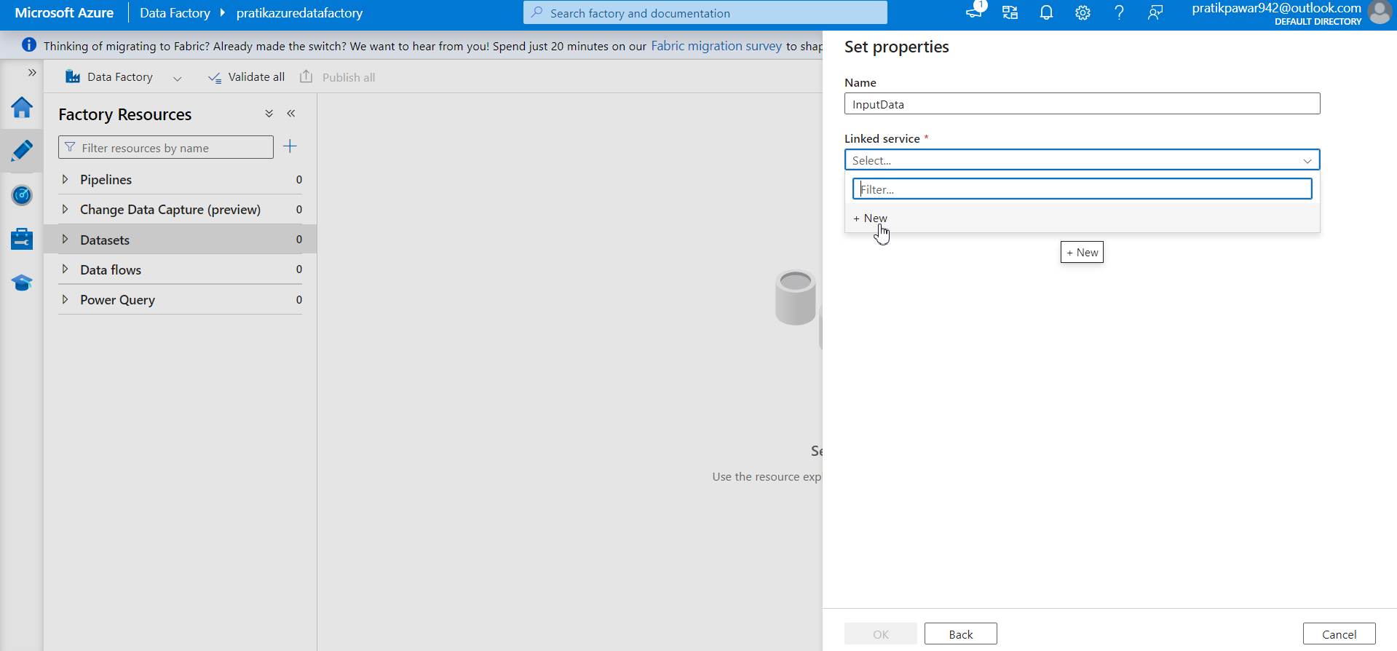
New Linked Service

Slide 10
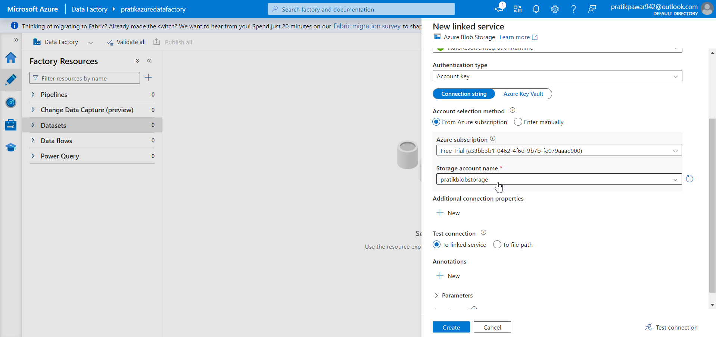
Select subscription and Storage account Name

Slide 11
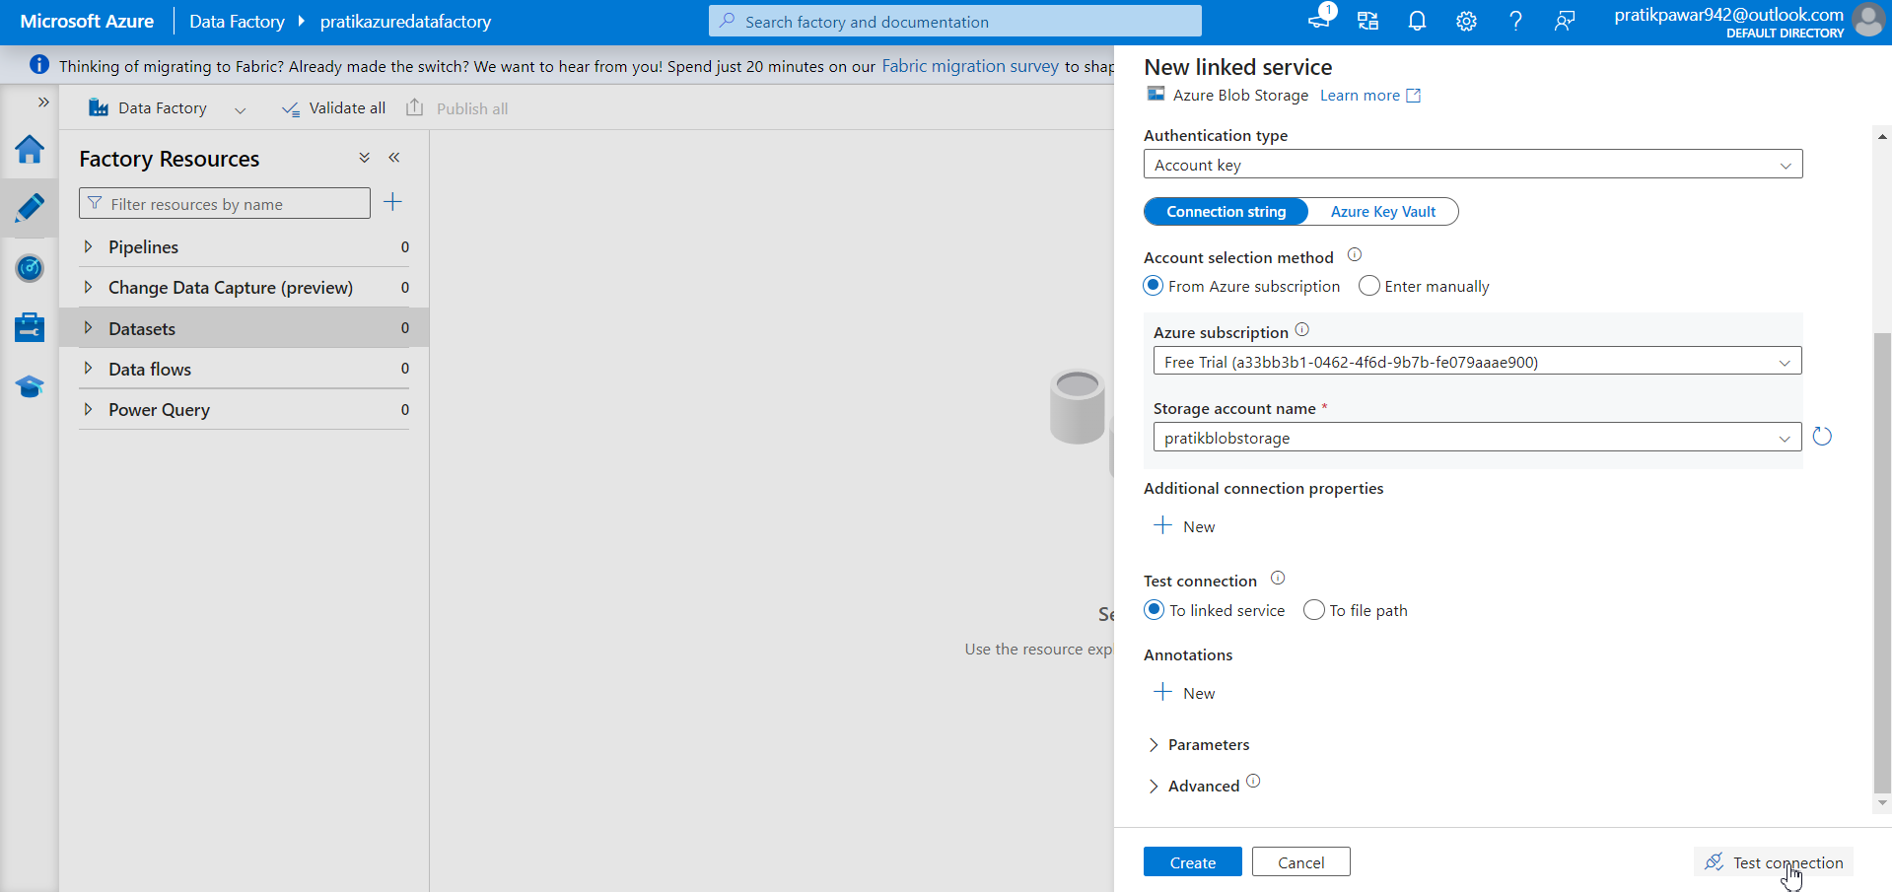
Test Connection

Slide 12
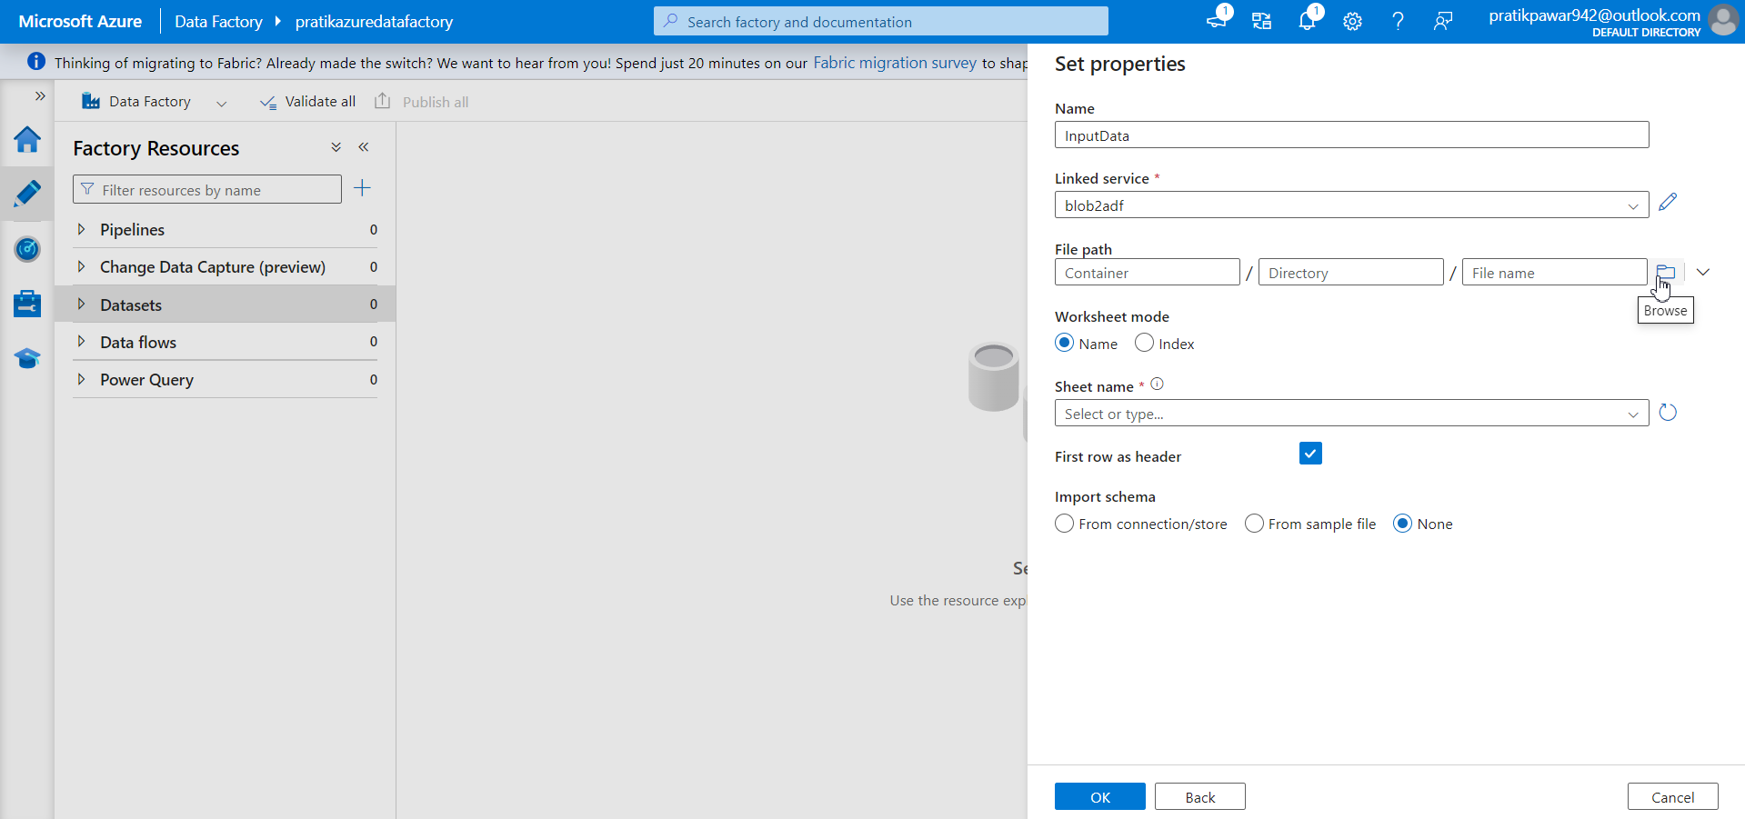
Select Path of Raw Data from Blob Storage

Slide 13
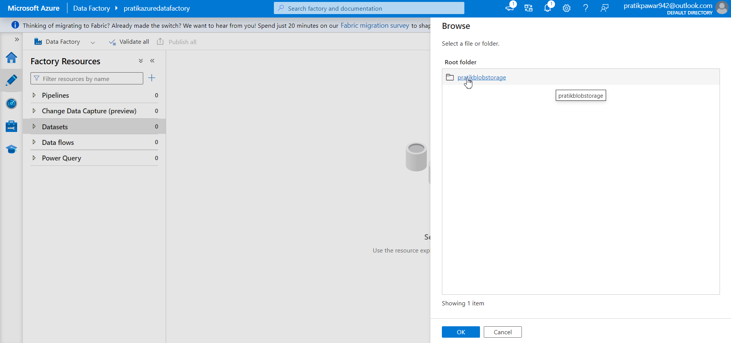
Pratikblobstorage

Slide 14

Bike_data.xlsx

Slide 15
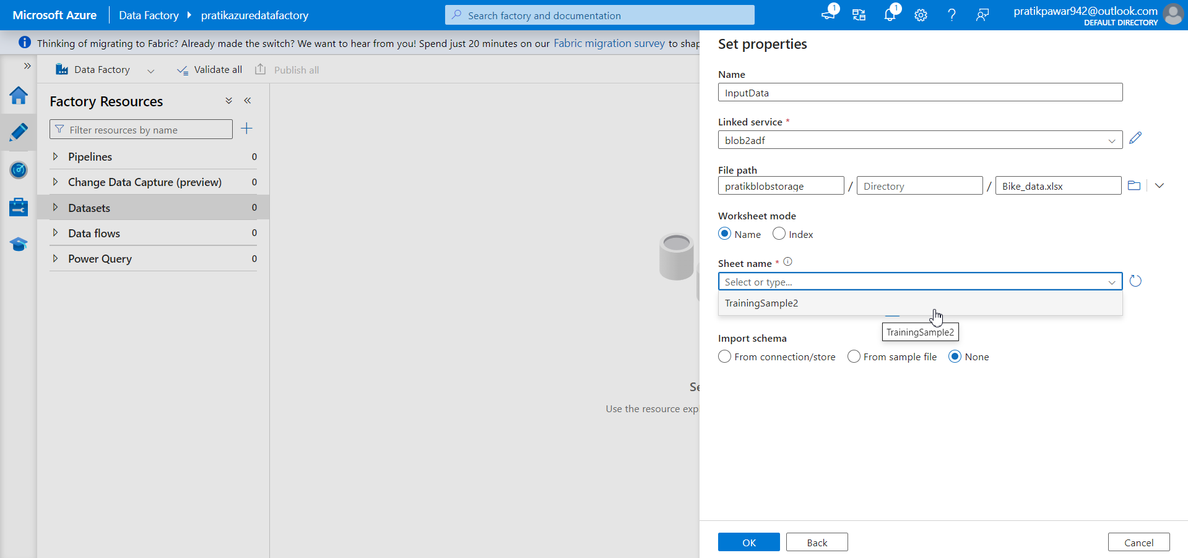
Select Sheet Name

Slide 16
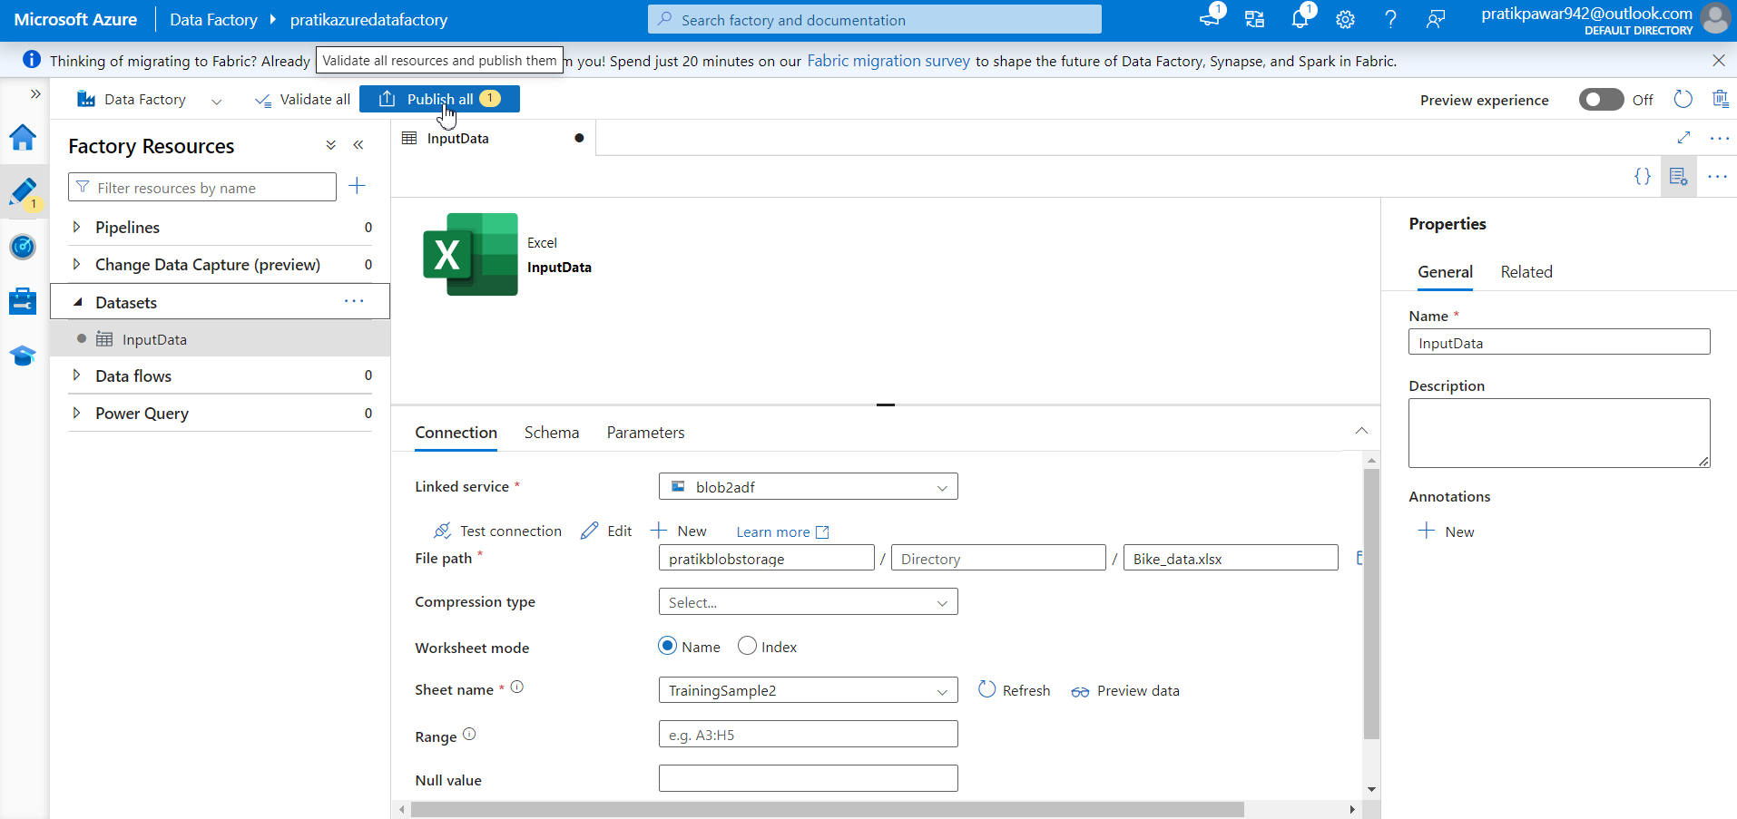
Now Publish to Save Data in ADF

Slide 17
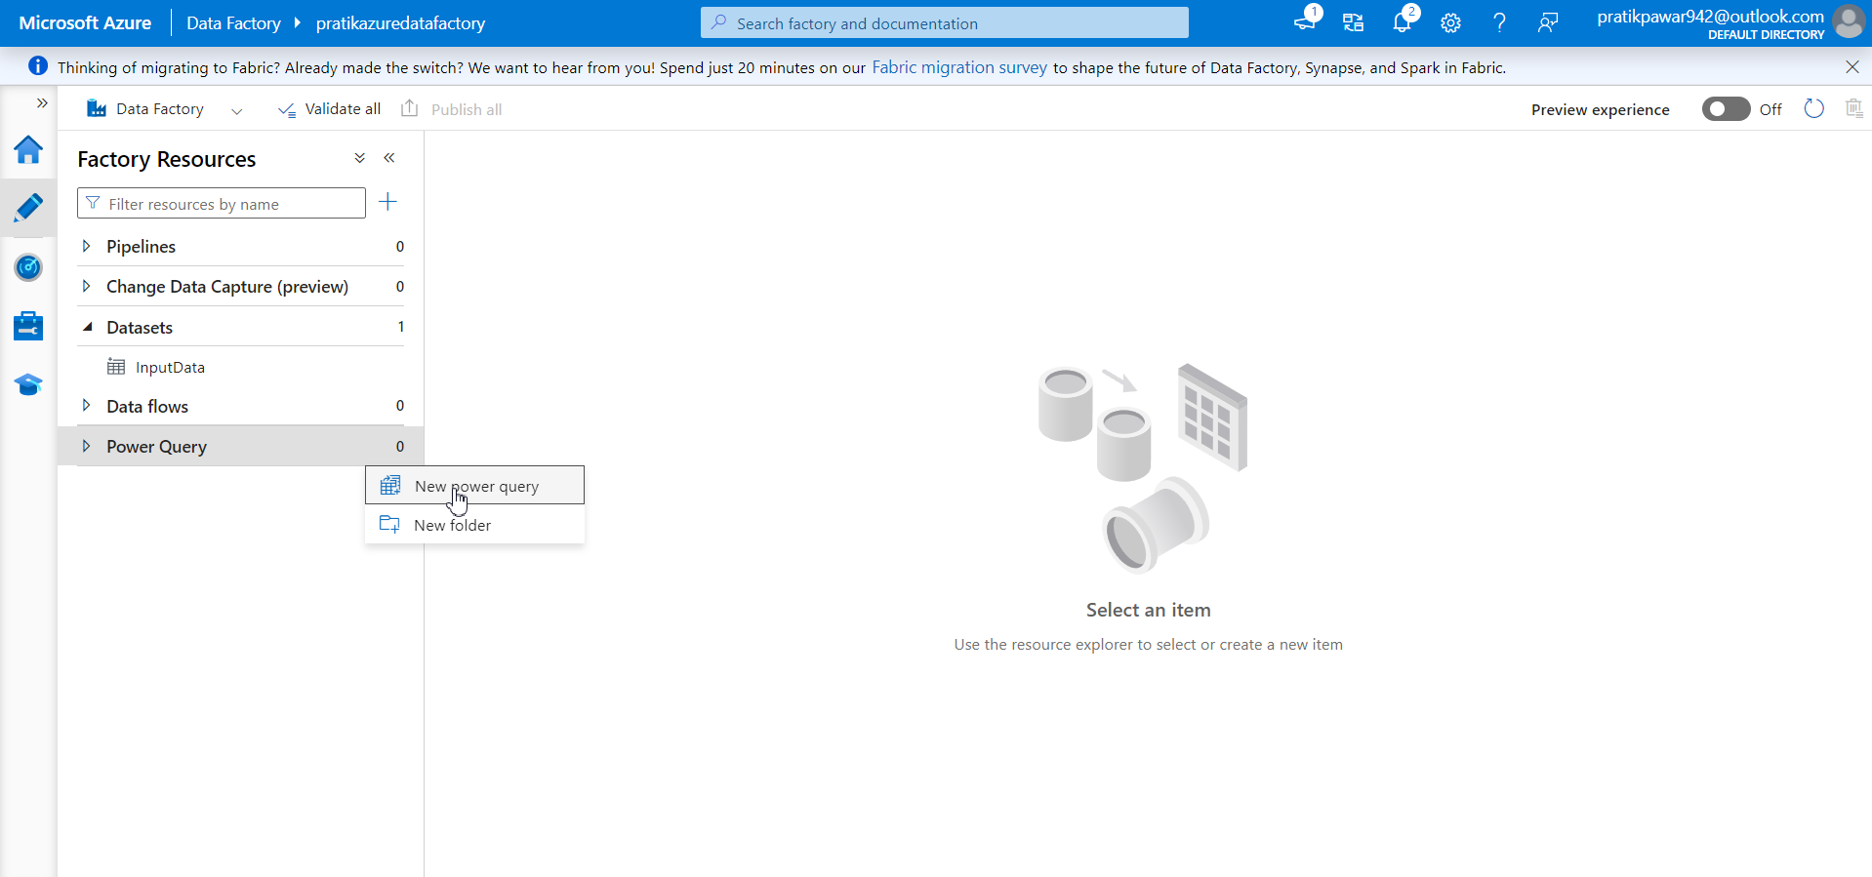
New Power Query

Slide 18
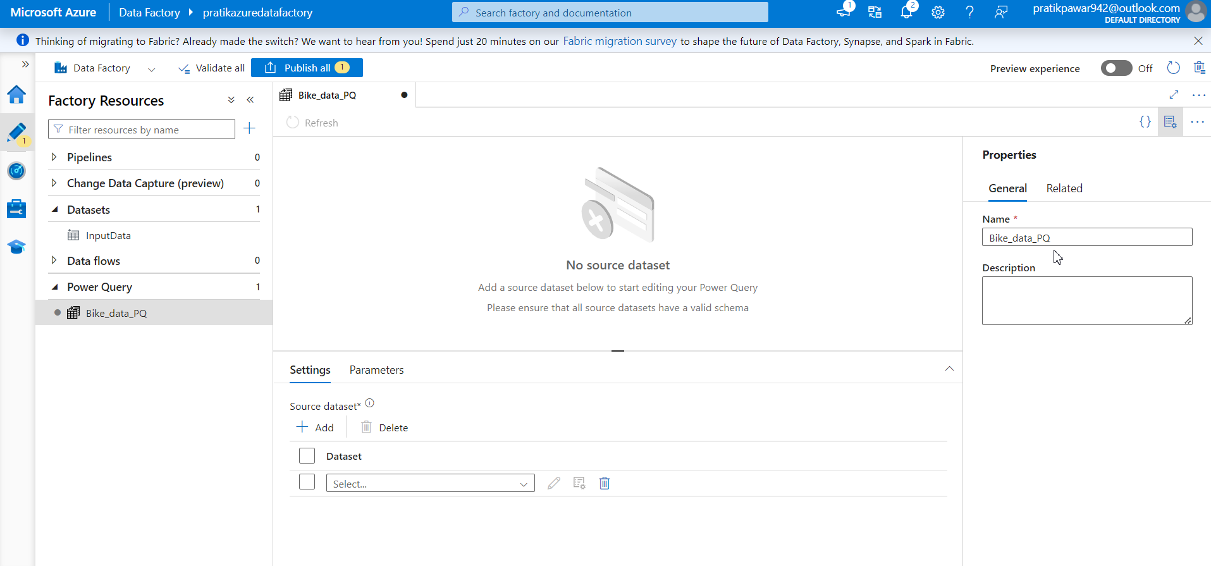
Give name = Bike_data_PQ

Slide 19
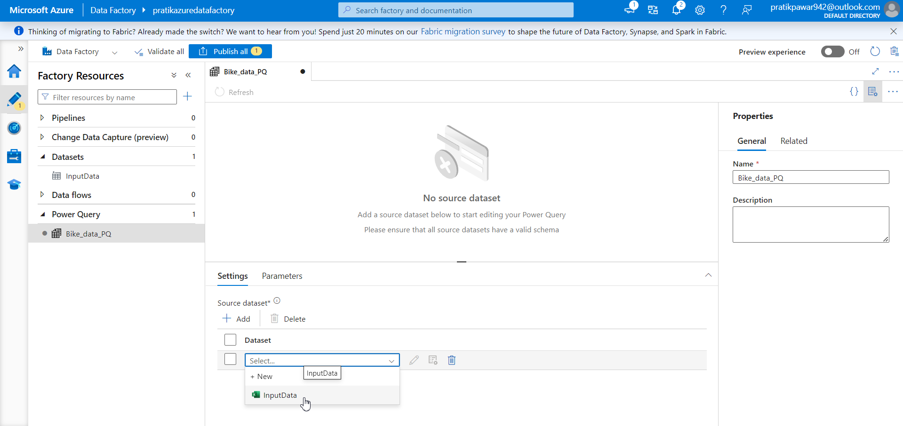
Select the dataset

Slide 20
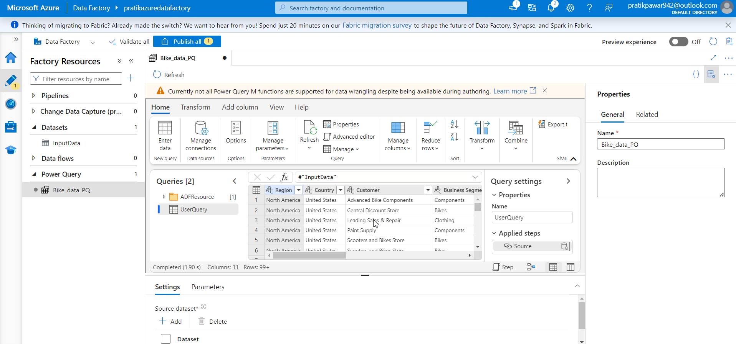
It automatically open data above

Slide 21
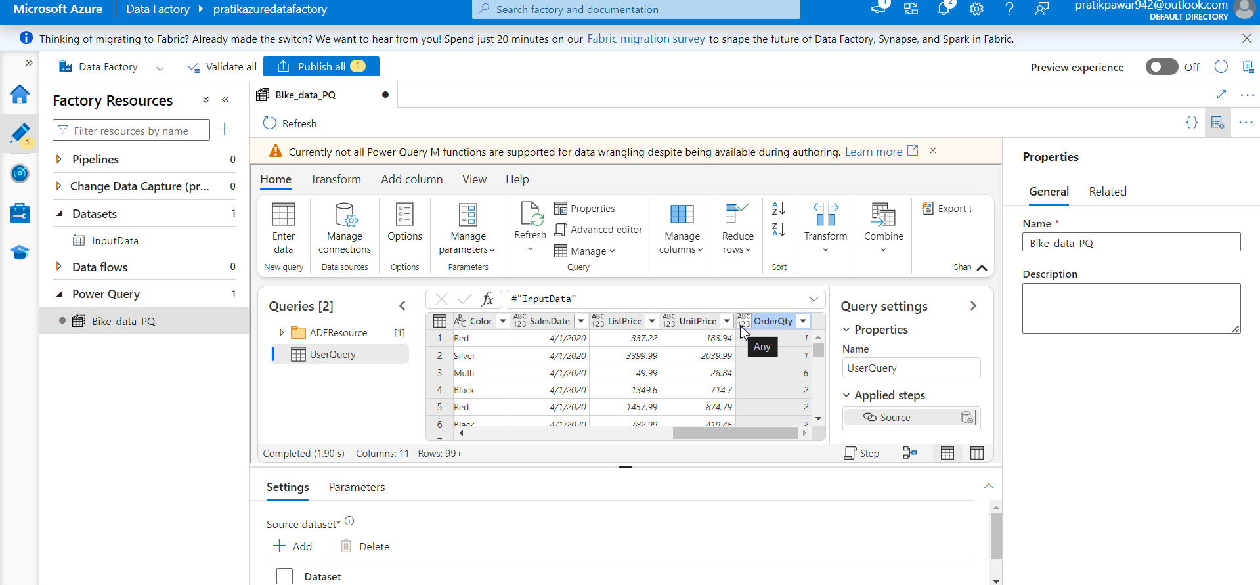
Change the datatype according to data

Slide 22
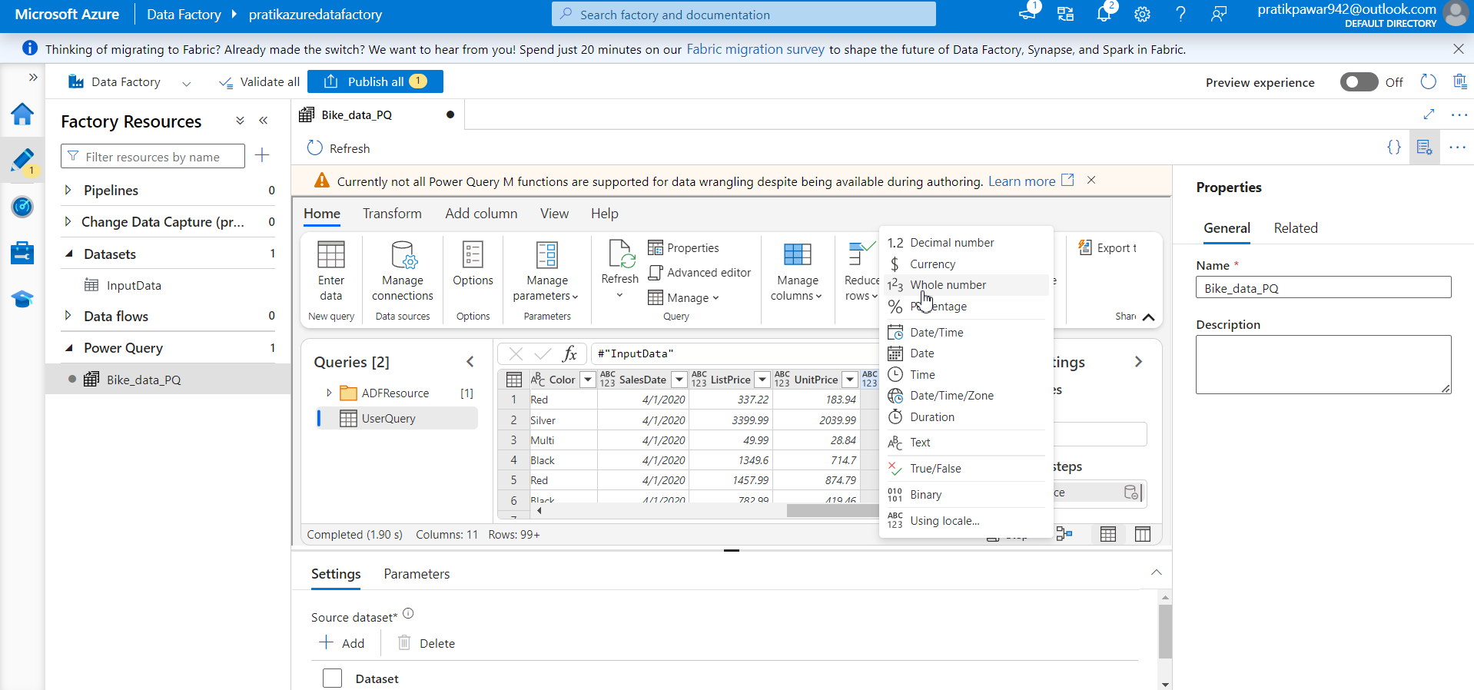
Change to whole number

Slide 23
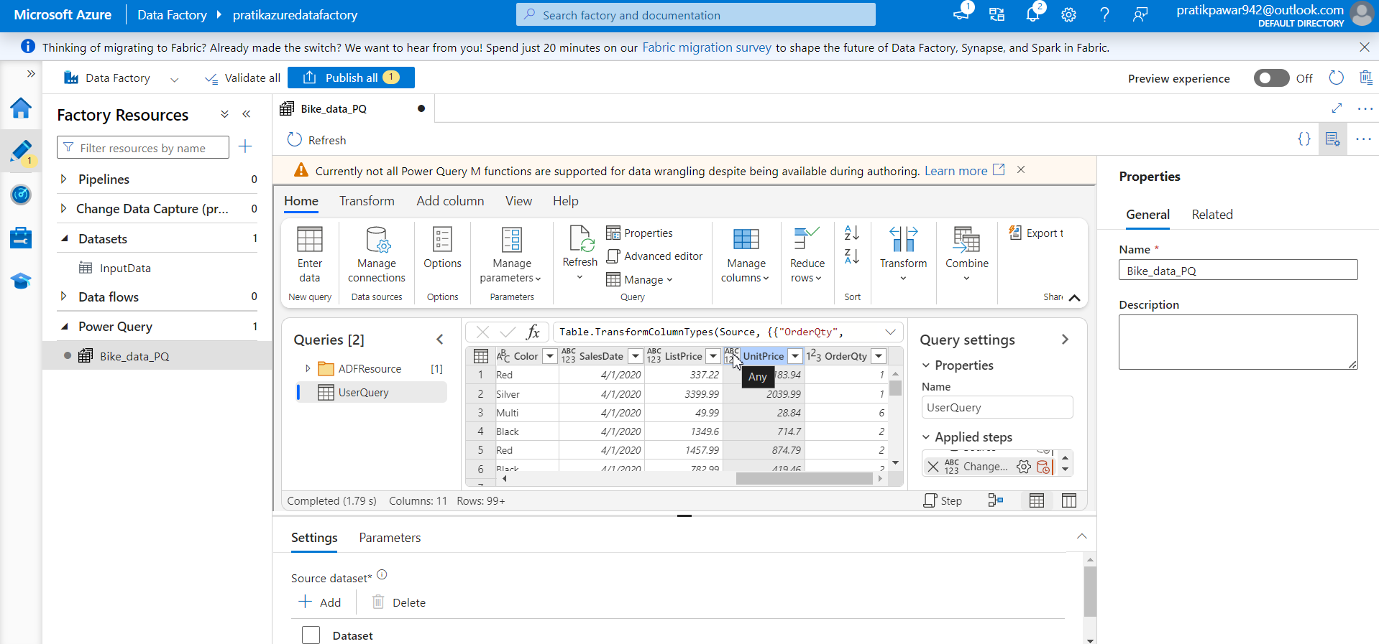
Change it decimal datatype (we have change the datatype as we have to perform calculation from that columns)

Slide 24
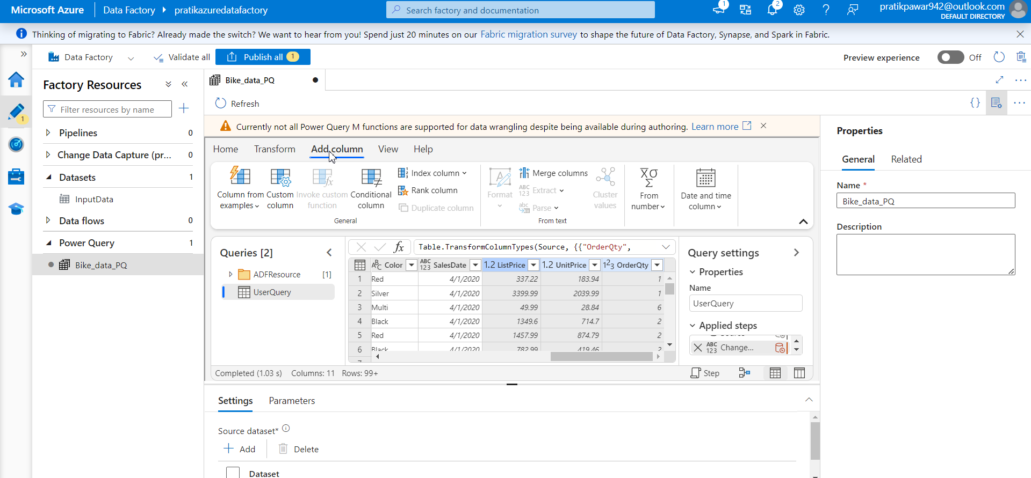
Go to Add Column

Slide 25
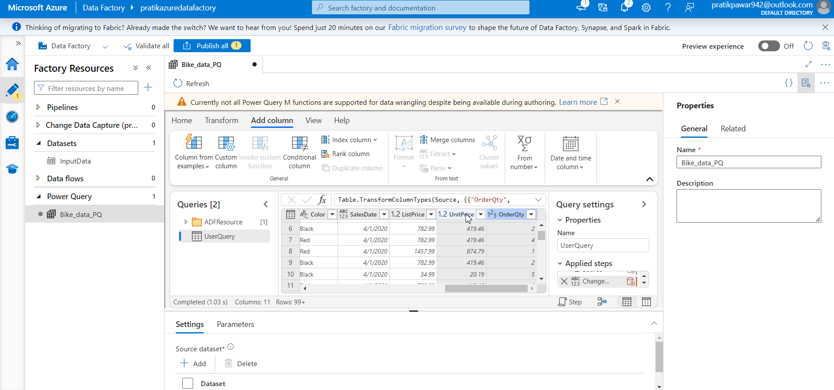
Select this both column by ctrl

Slide 26
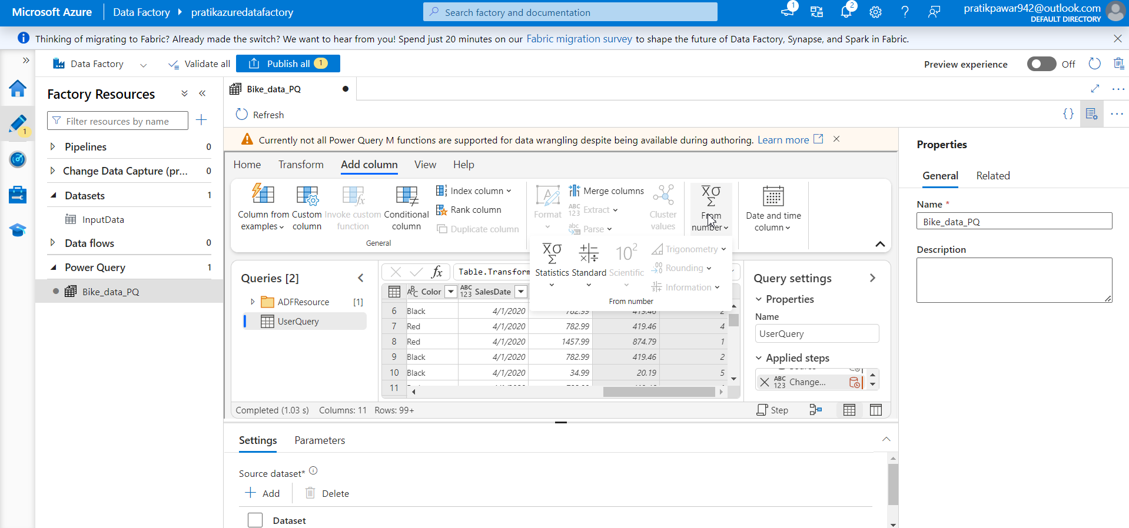
Go to from Number

Slide 27

Go to Standard

Slide 28
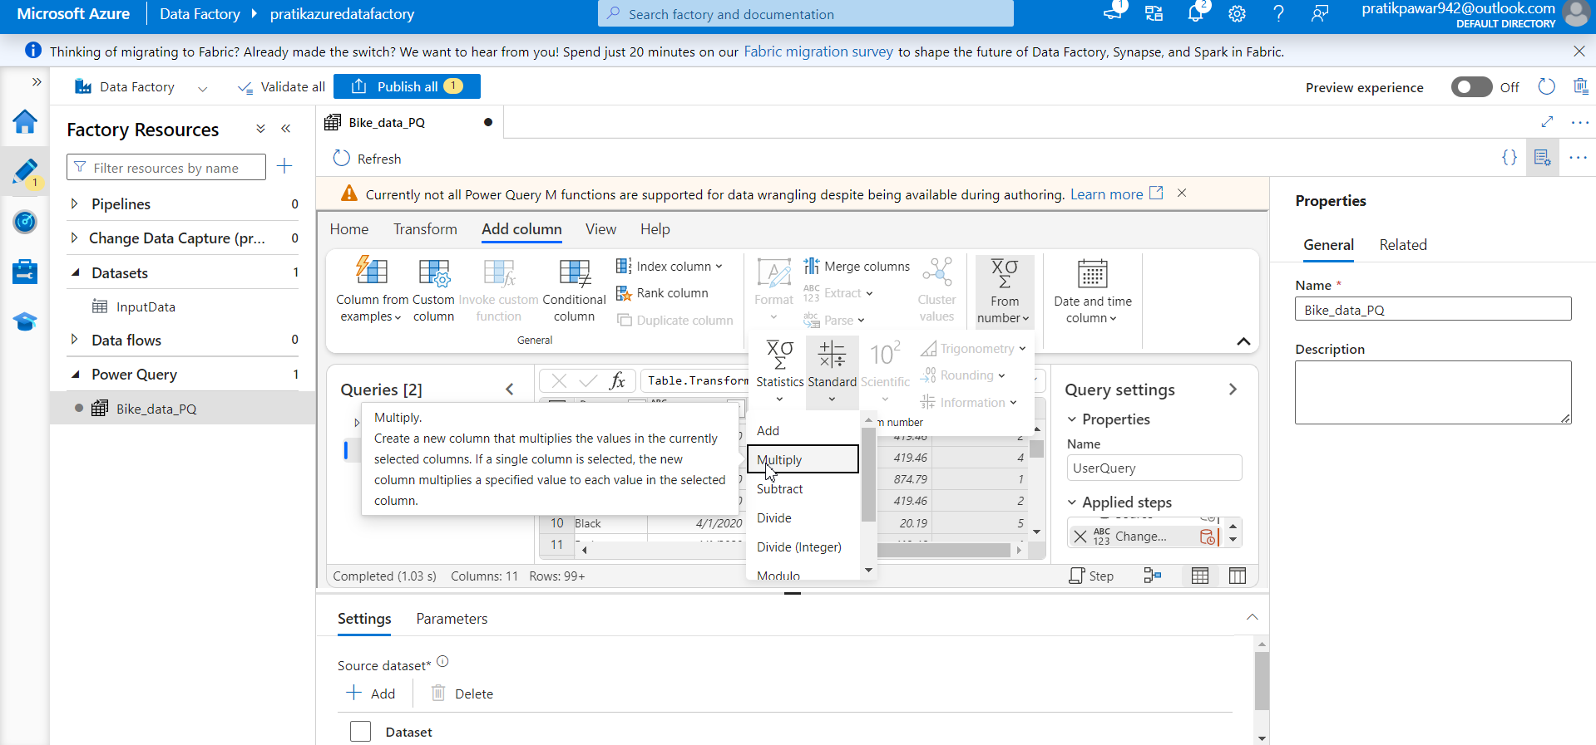
Select multiply

Slide 29
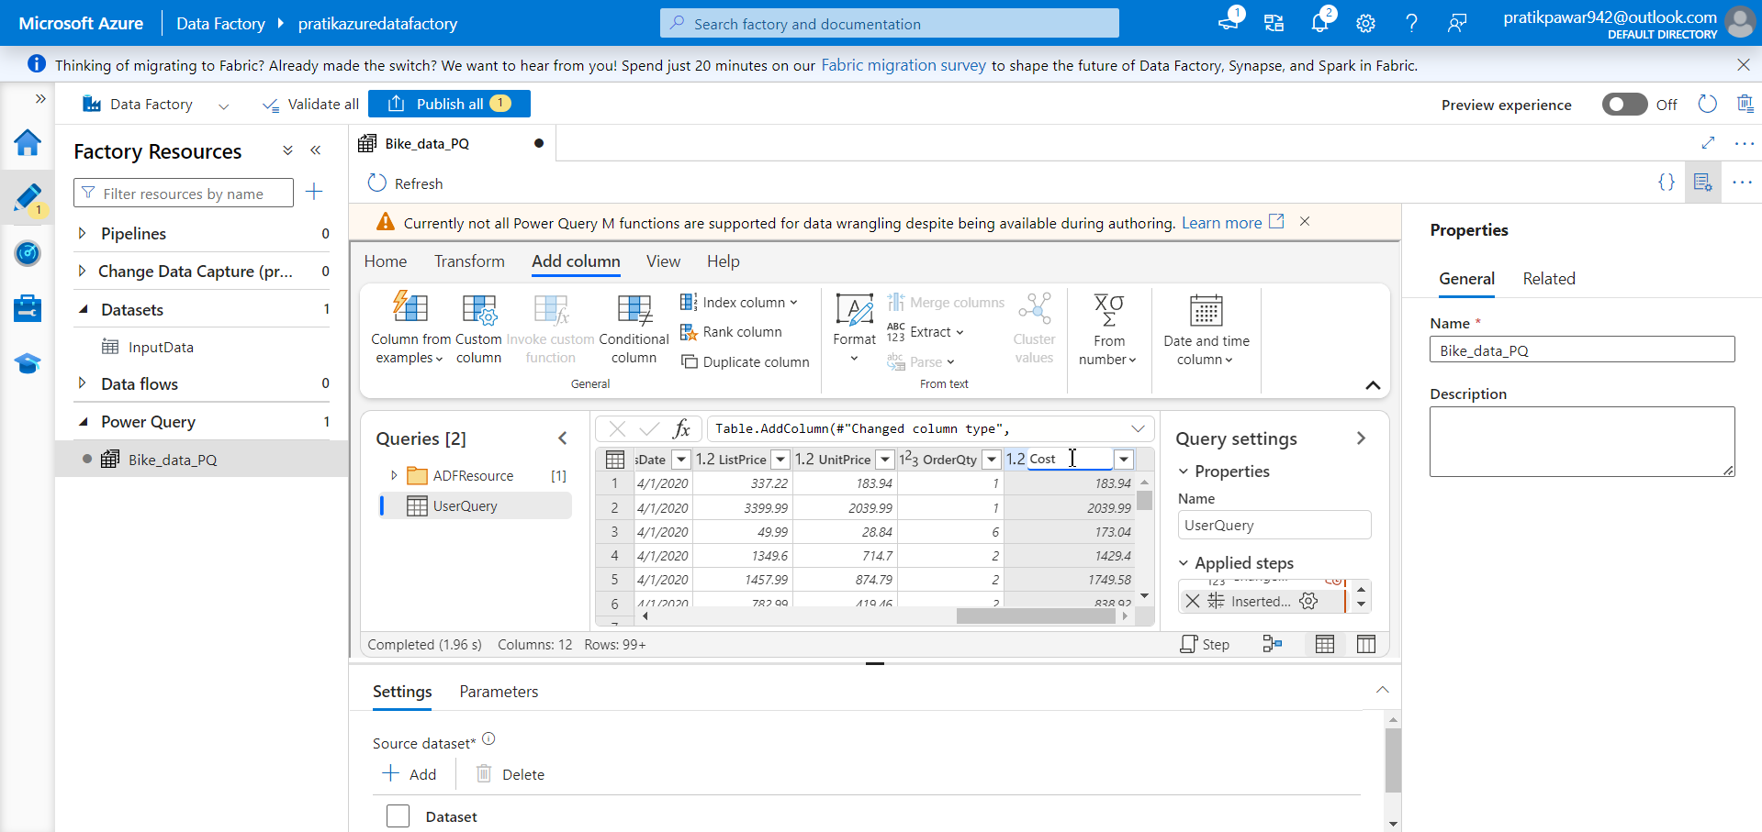
New column has added. Change column name to cost by doble click

Slide 30

In same manner, create sales column by multiplying listPrice * orderQTY

Slide 31

Now create Profit column by Cost-sales

Slide 32
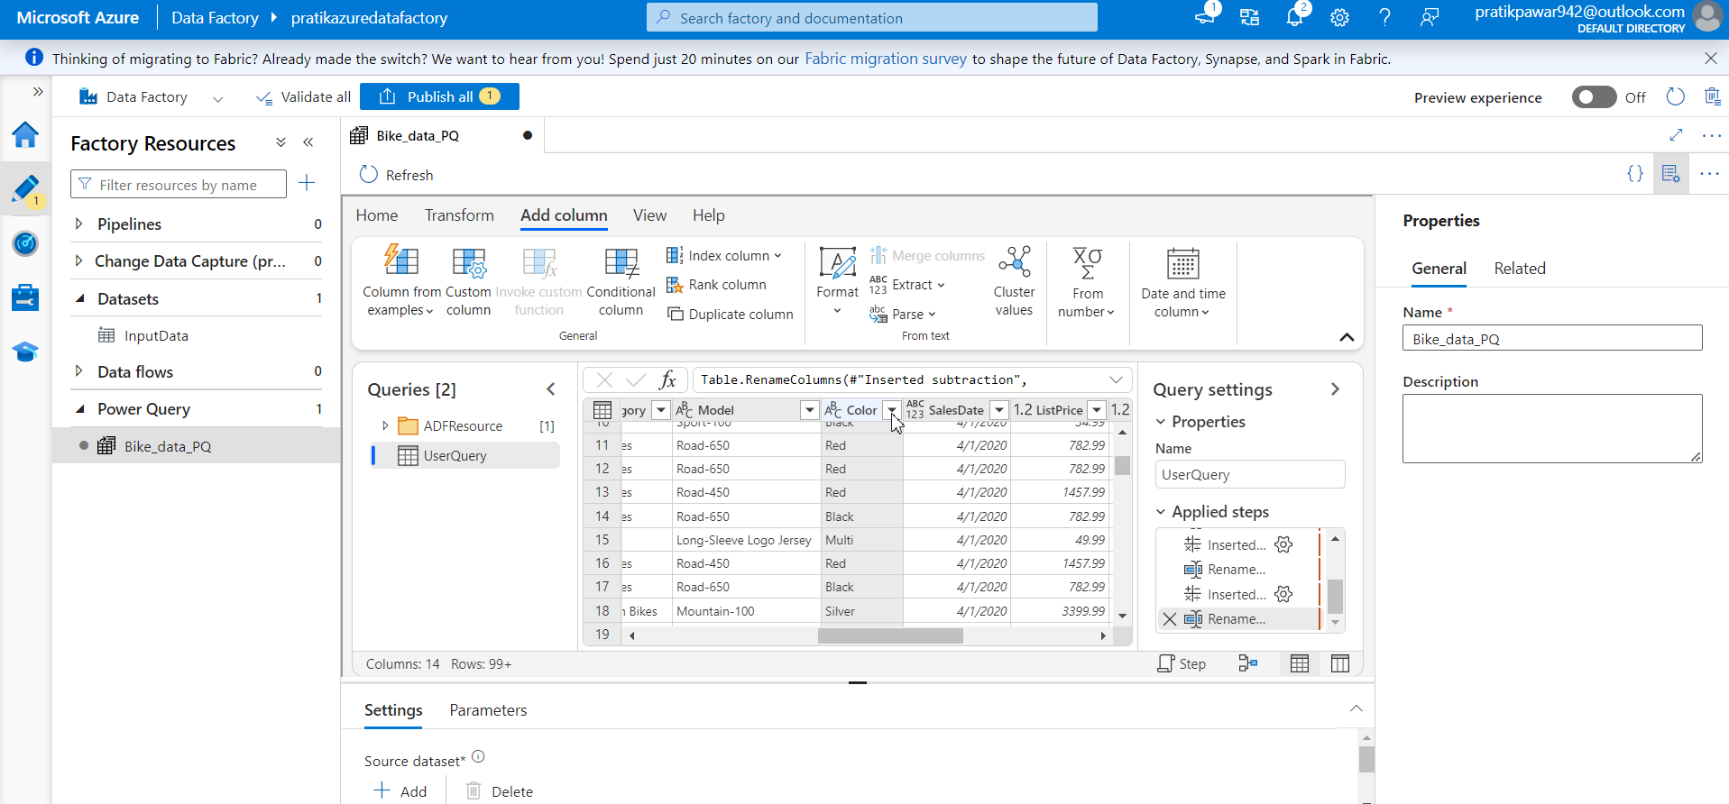
Click on this icon

Slide 33
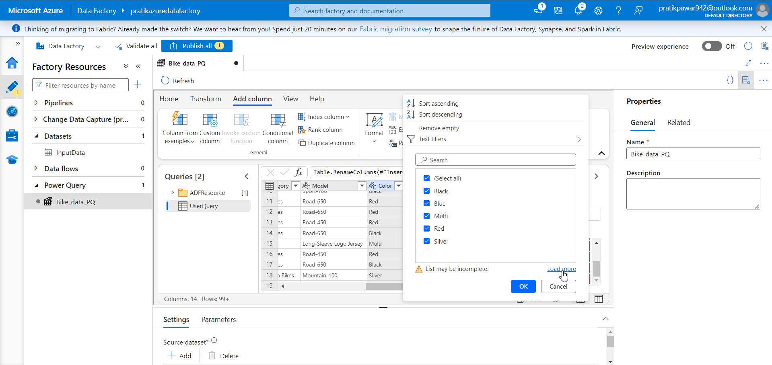
Now select load more to see all distinct values

Slide 34
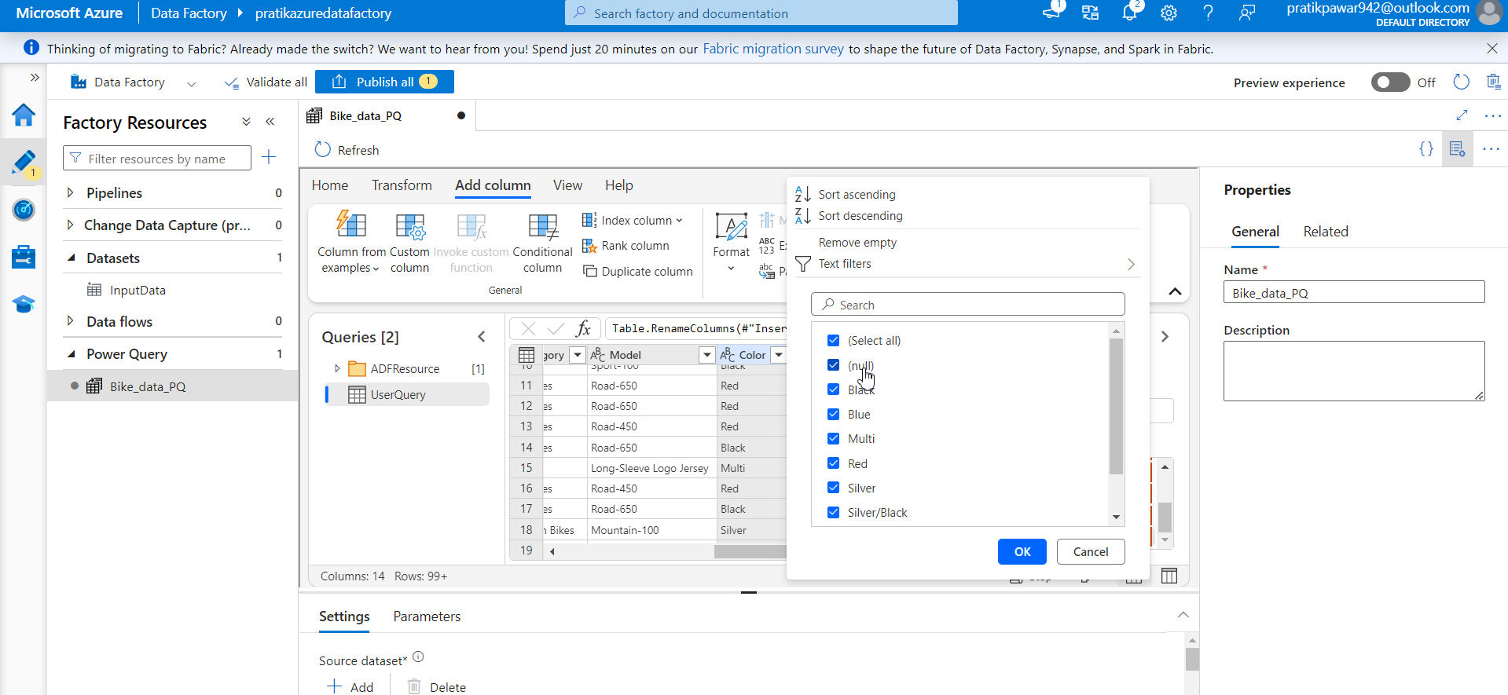
Now this column has some null values

Slide 35
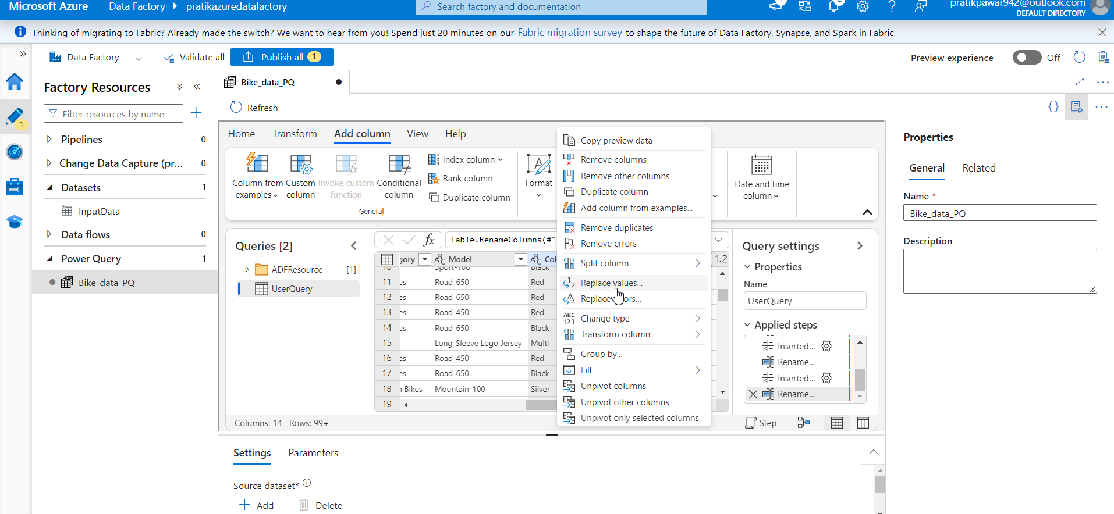
Now Right Click on Column and Replace Values

Slide 36
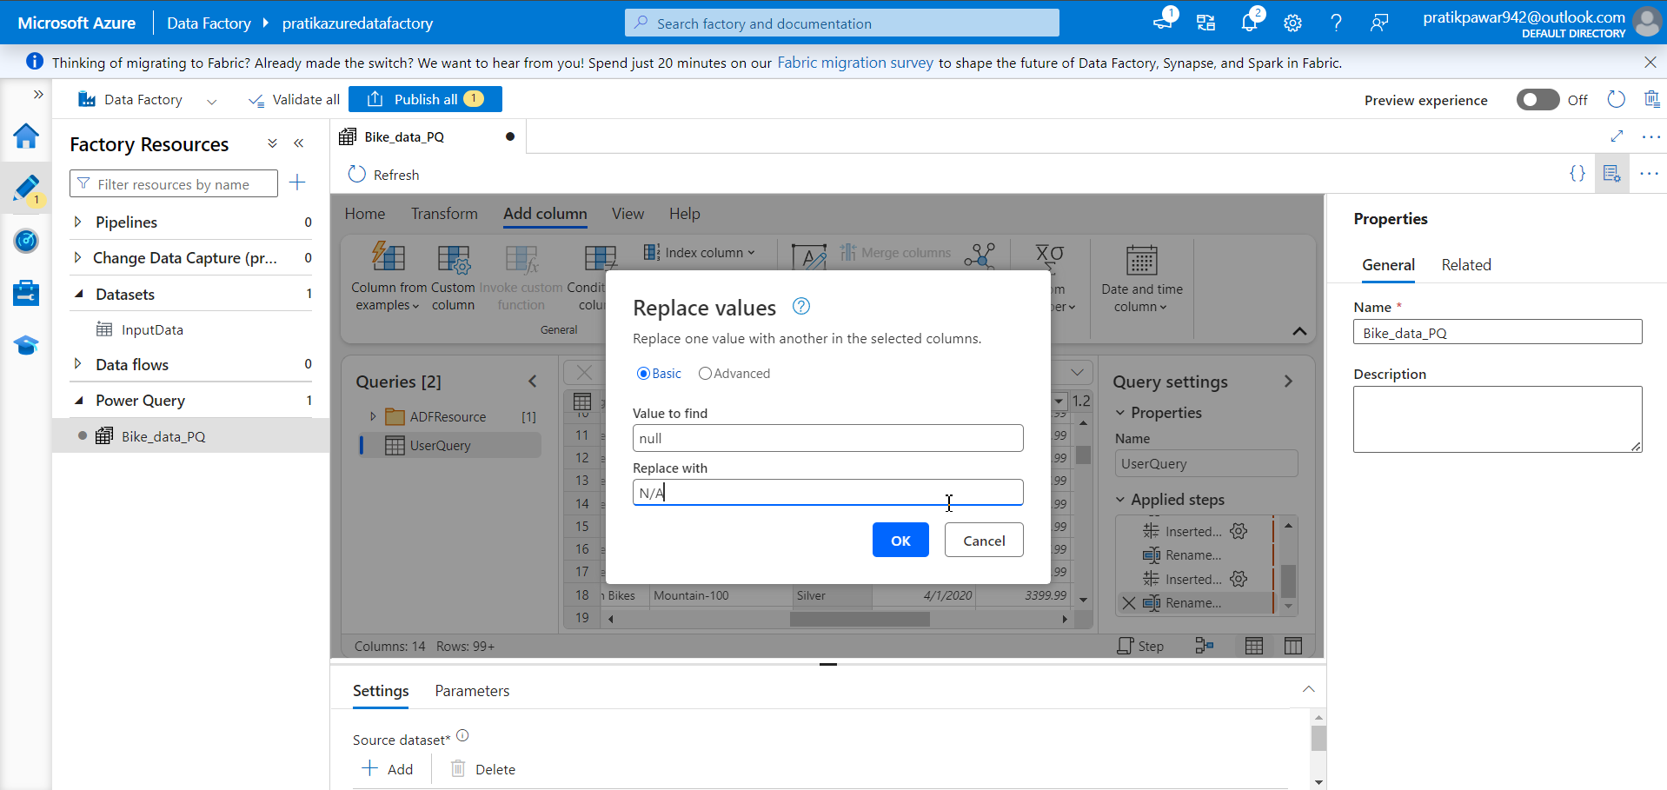
Replace null with Not available

Slide 37
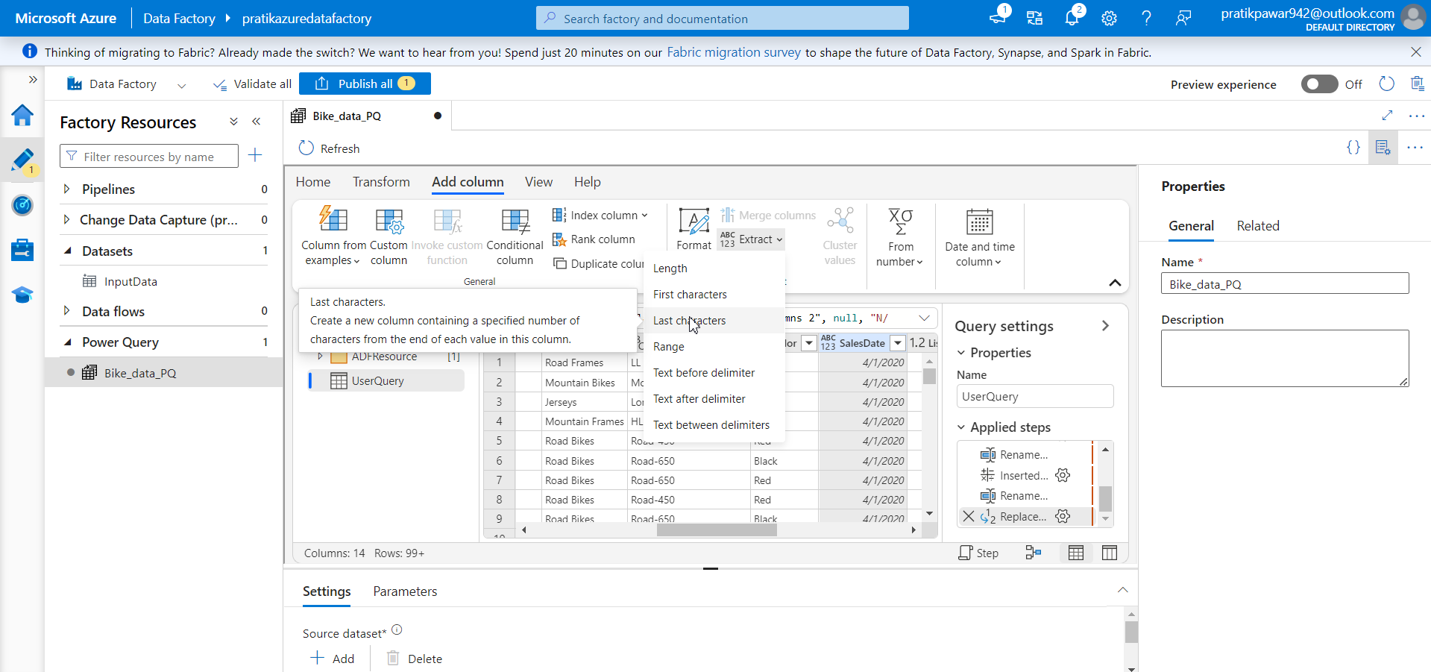
Go to Extract → Last Characters

Slide 38
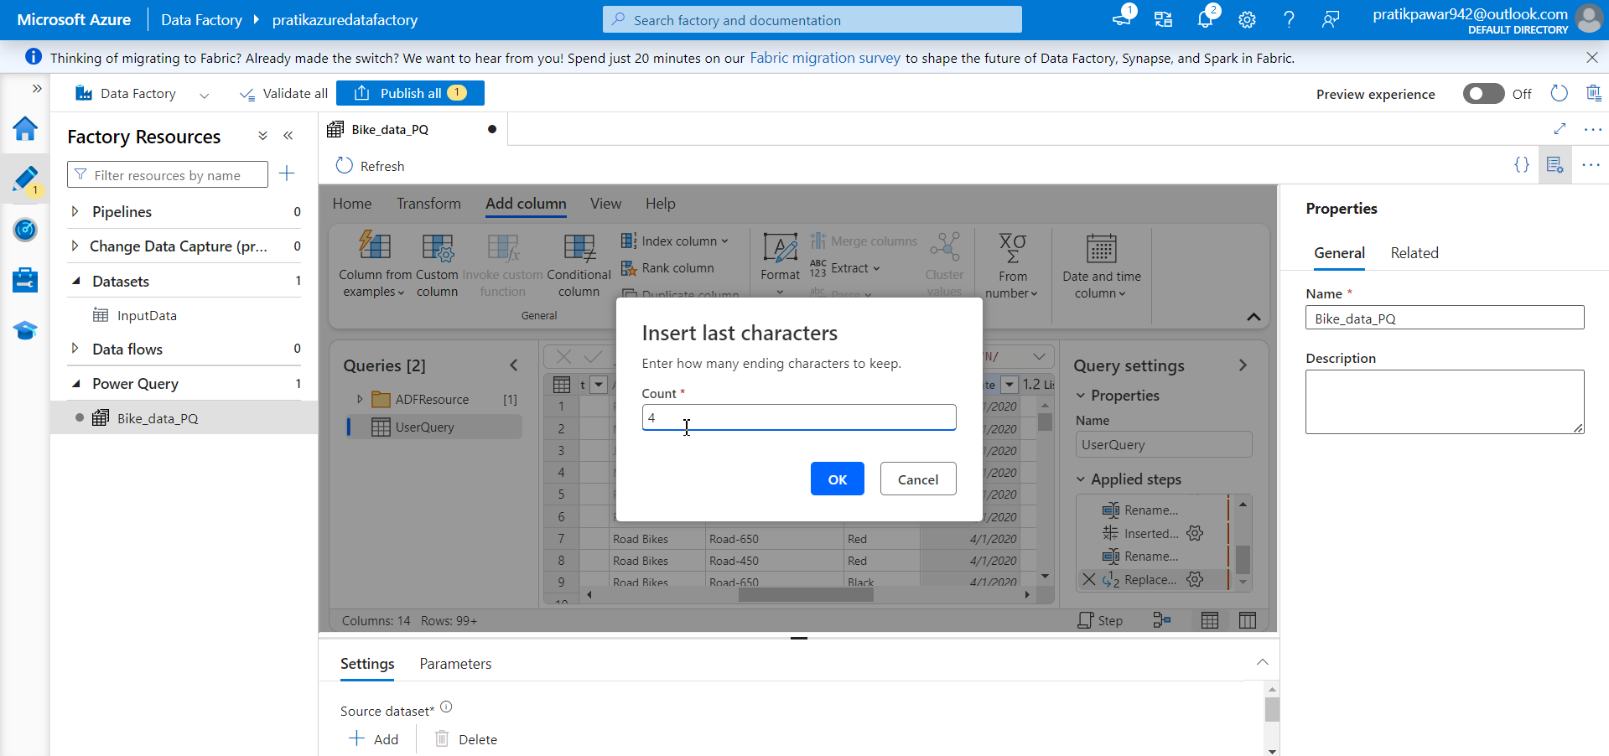
Give 4 ( this will give you separate column of year)

Slide 39
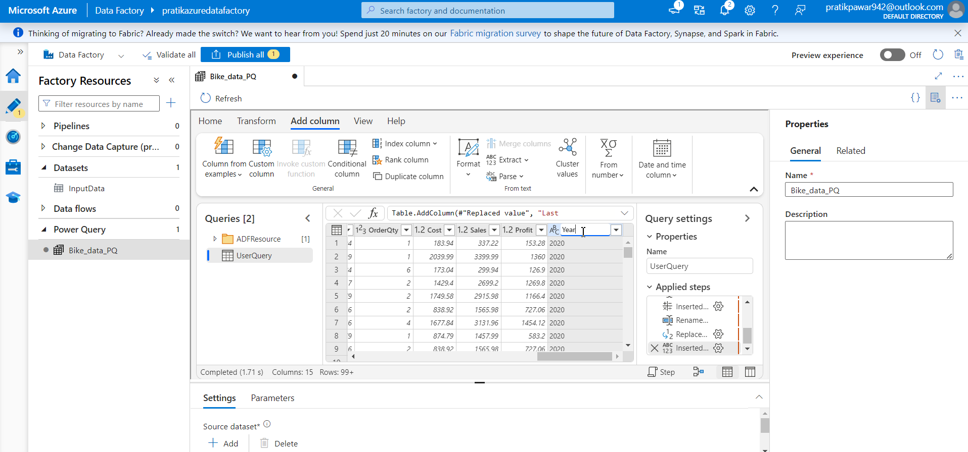
Replace name with Year

Slide 40
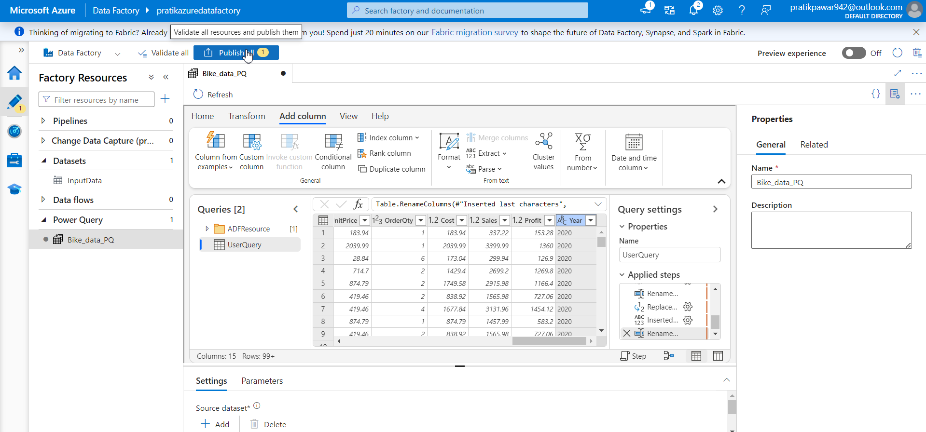
Now Publish to save all transformation

Slide 41
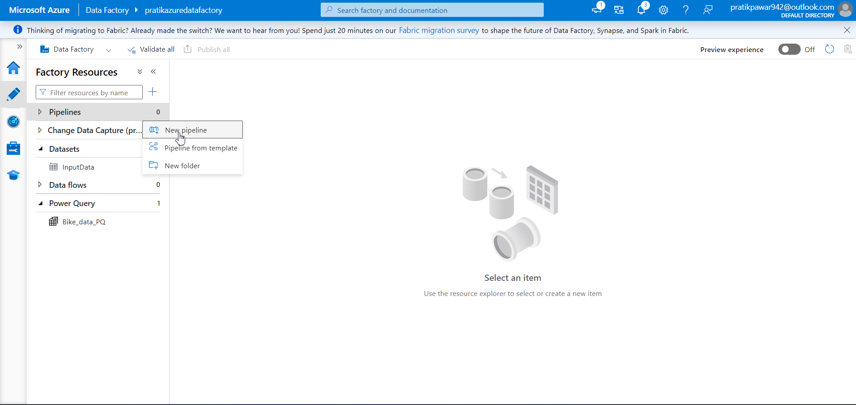
Create new pipeline

Slide 42
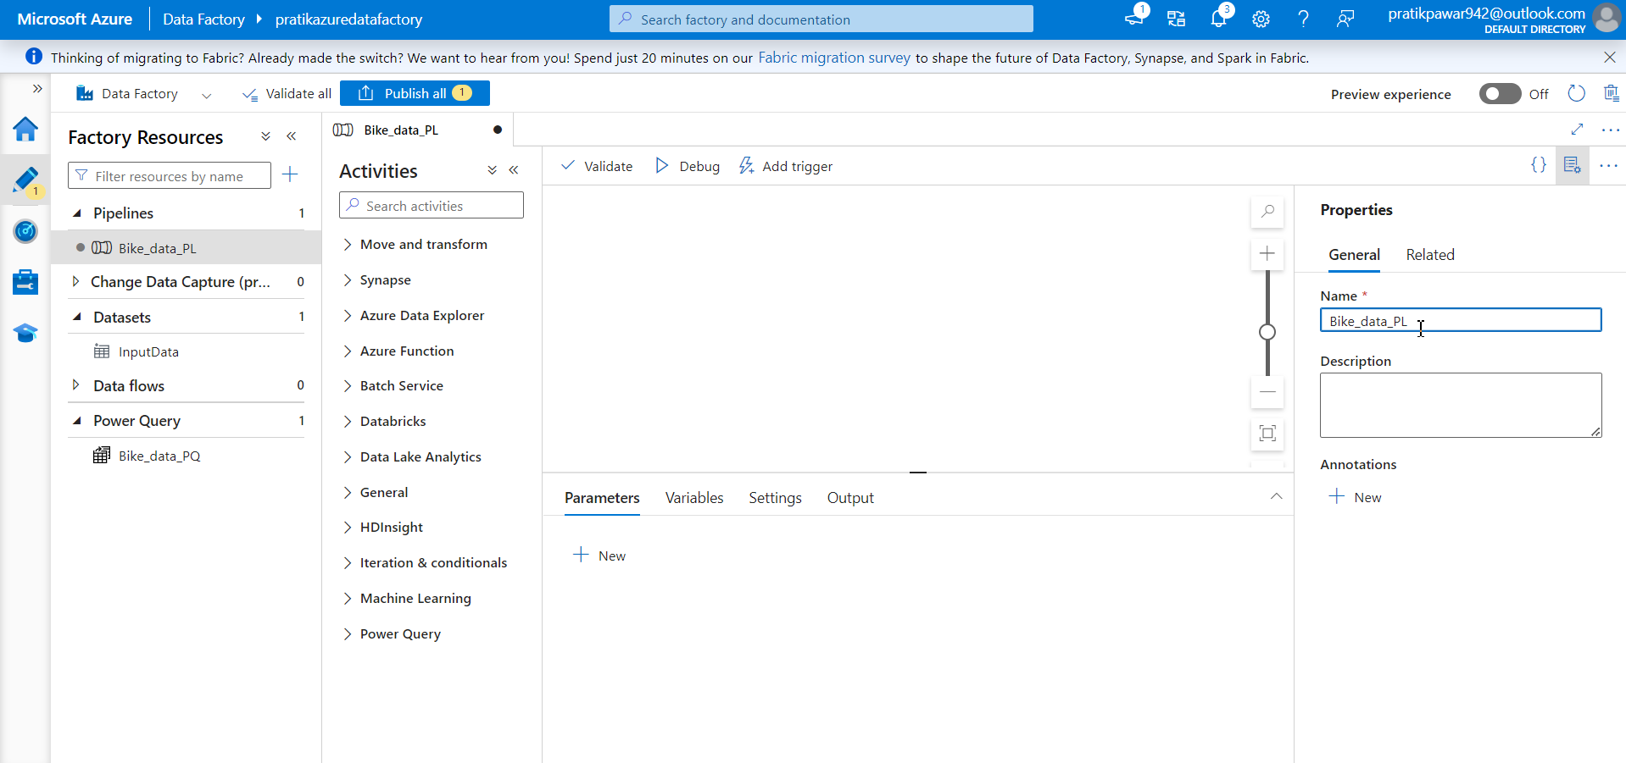
Name Pipeline = Bike_data_PL

Slide 43
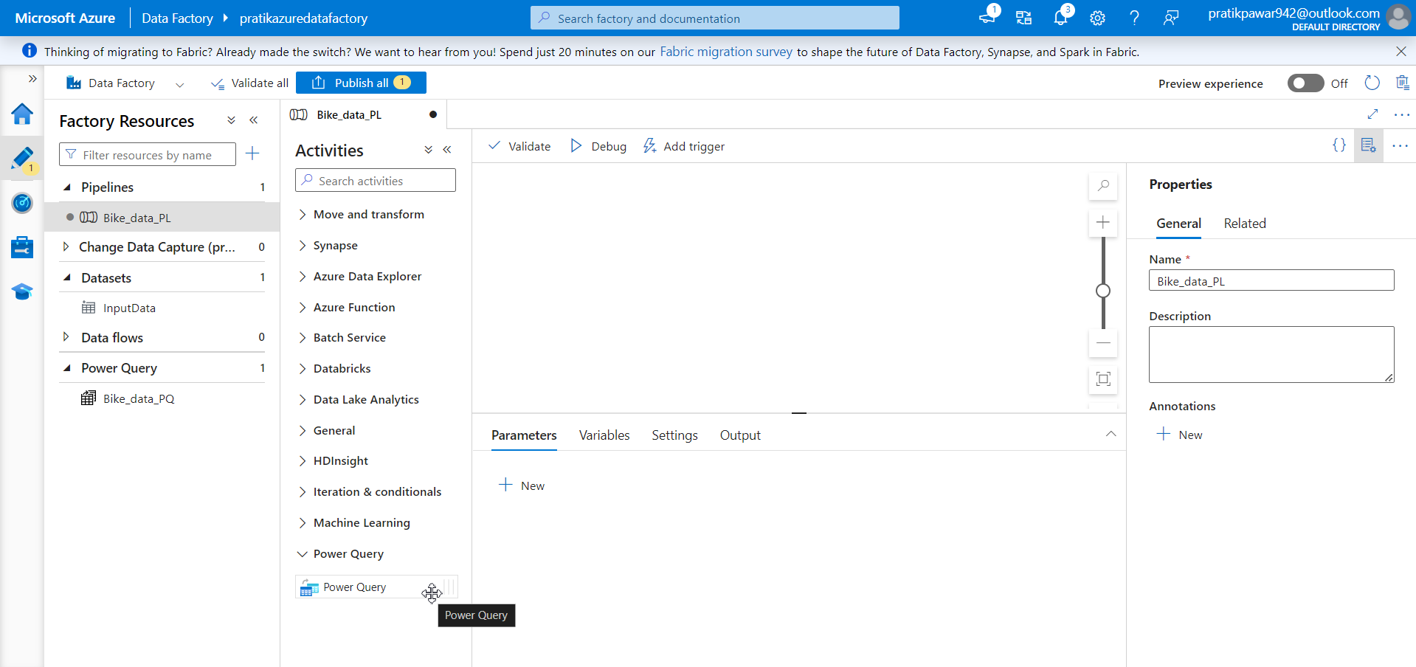
Now go to Power Query and put it in open space as we transform data in power query

Slide 44
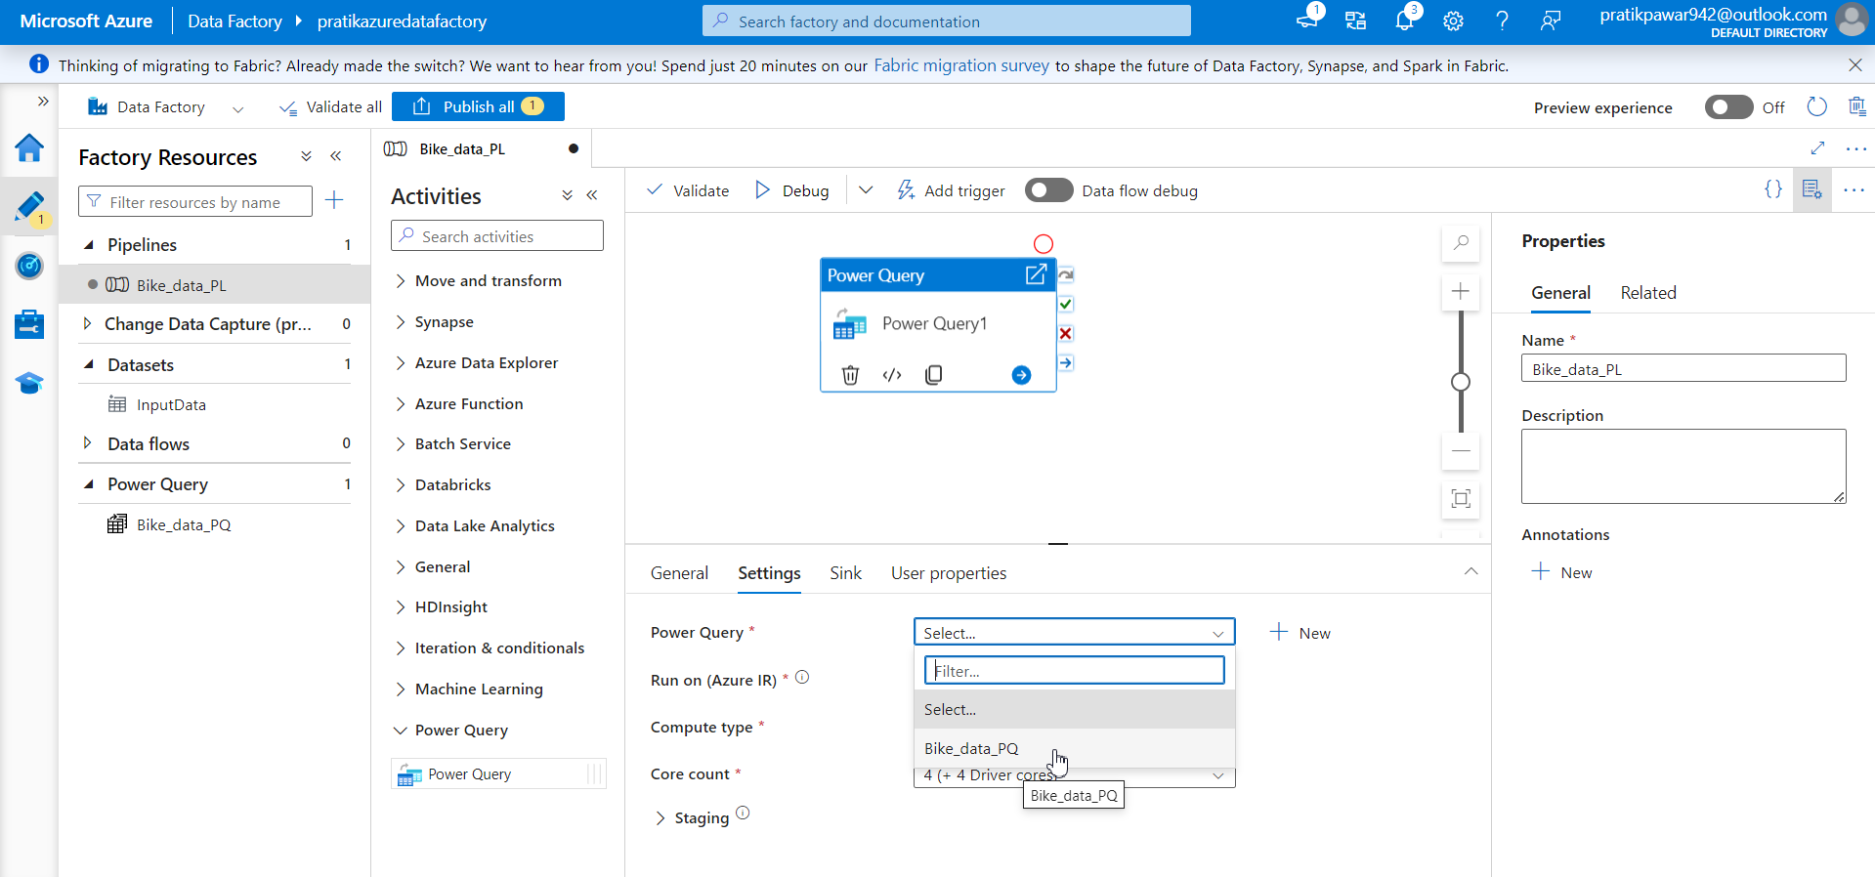
Now go to settings and add Bike_data_PQ

Slide 45
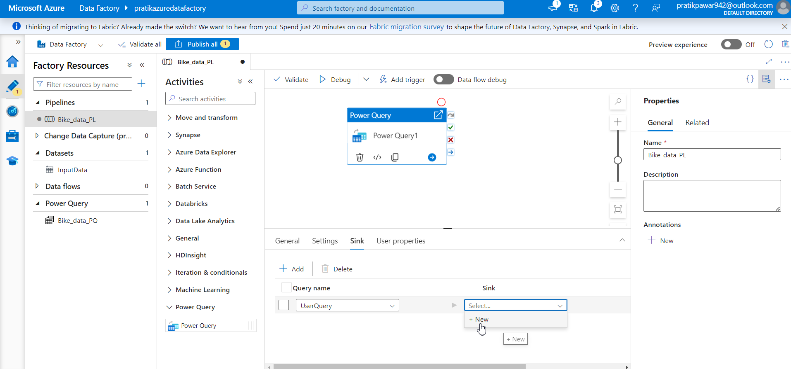
Now go to sink and create new sink

Slide 46
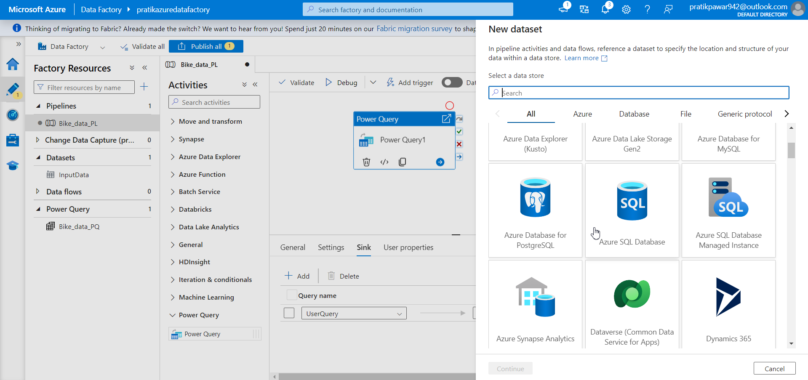
Azure SQL Database

Slide 47
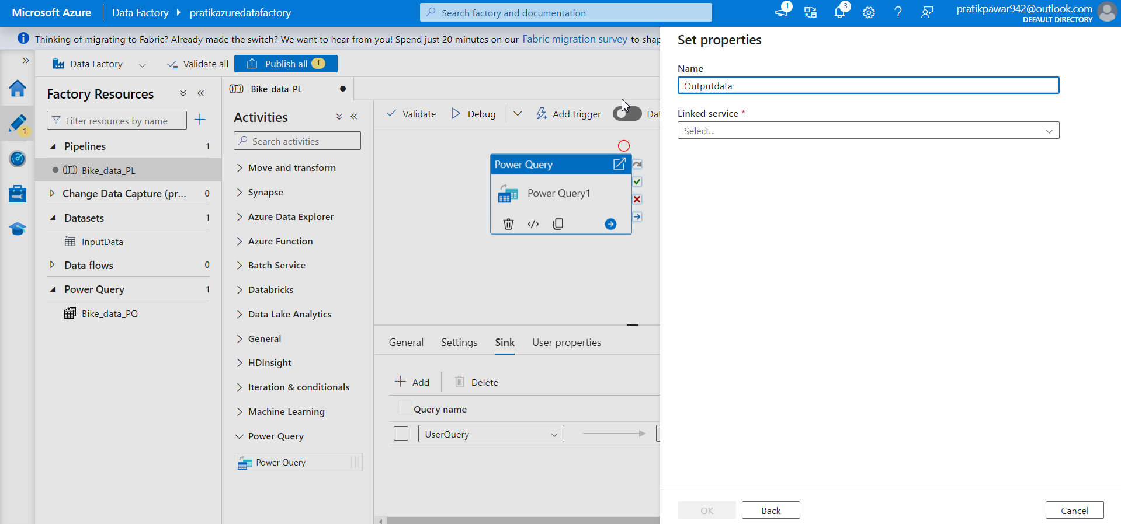
Create data Outputdata

Slide 48
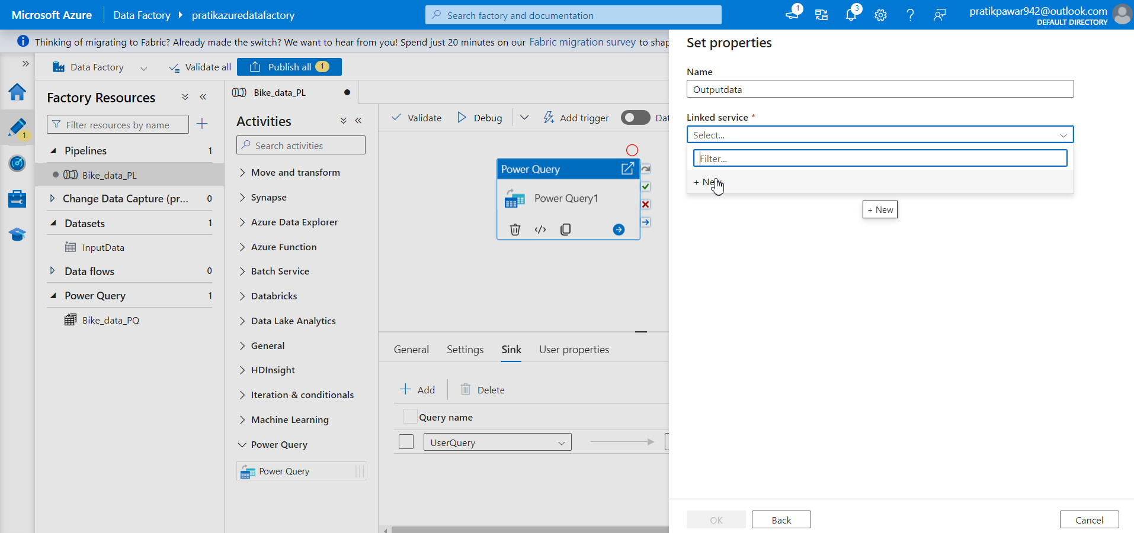
Linked Service → new

Slide 49
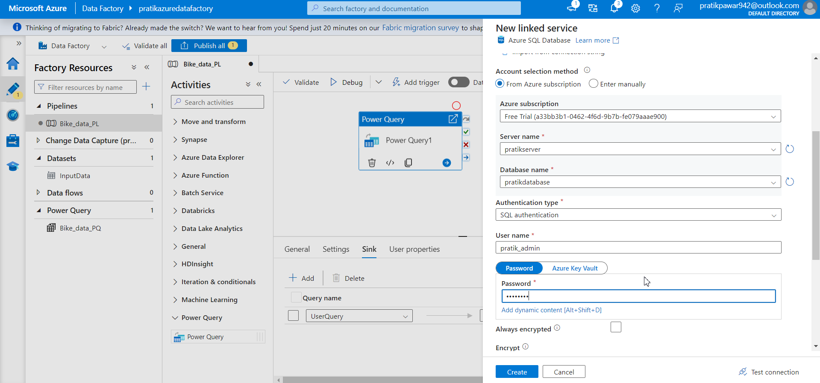
Fill all the details

Slide 50
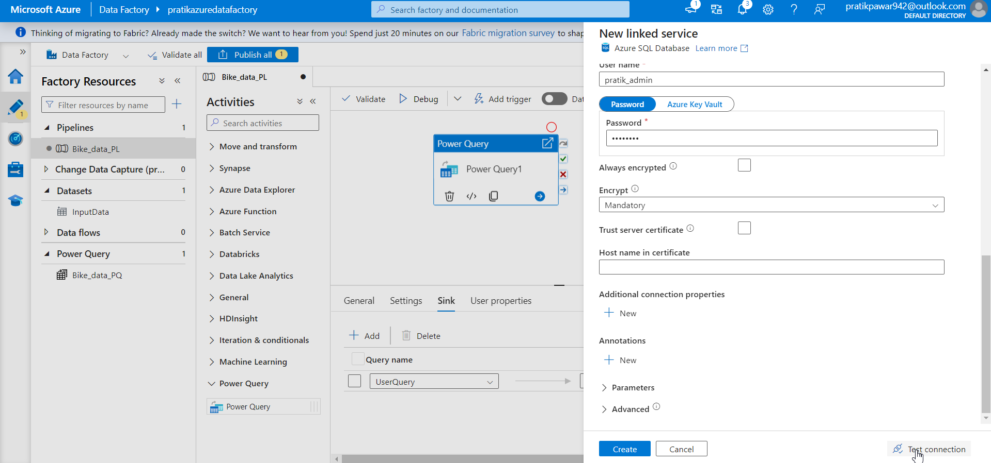
Test Connection

Slide 51
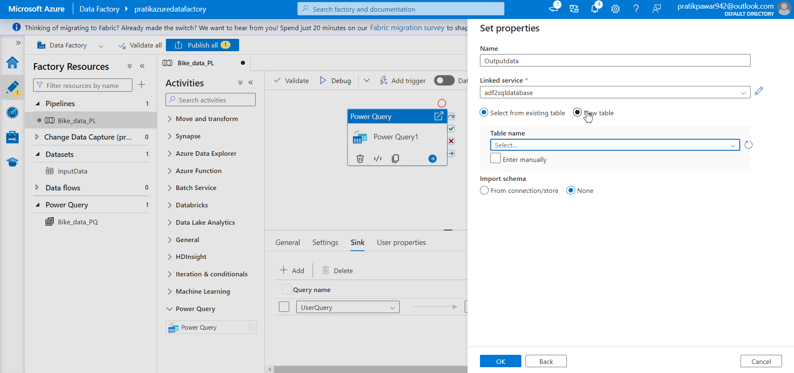
New table

Slide 52

Give table name

Slide 53
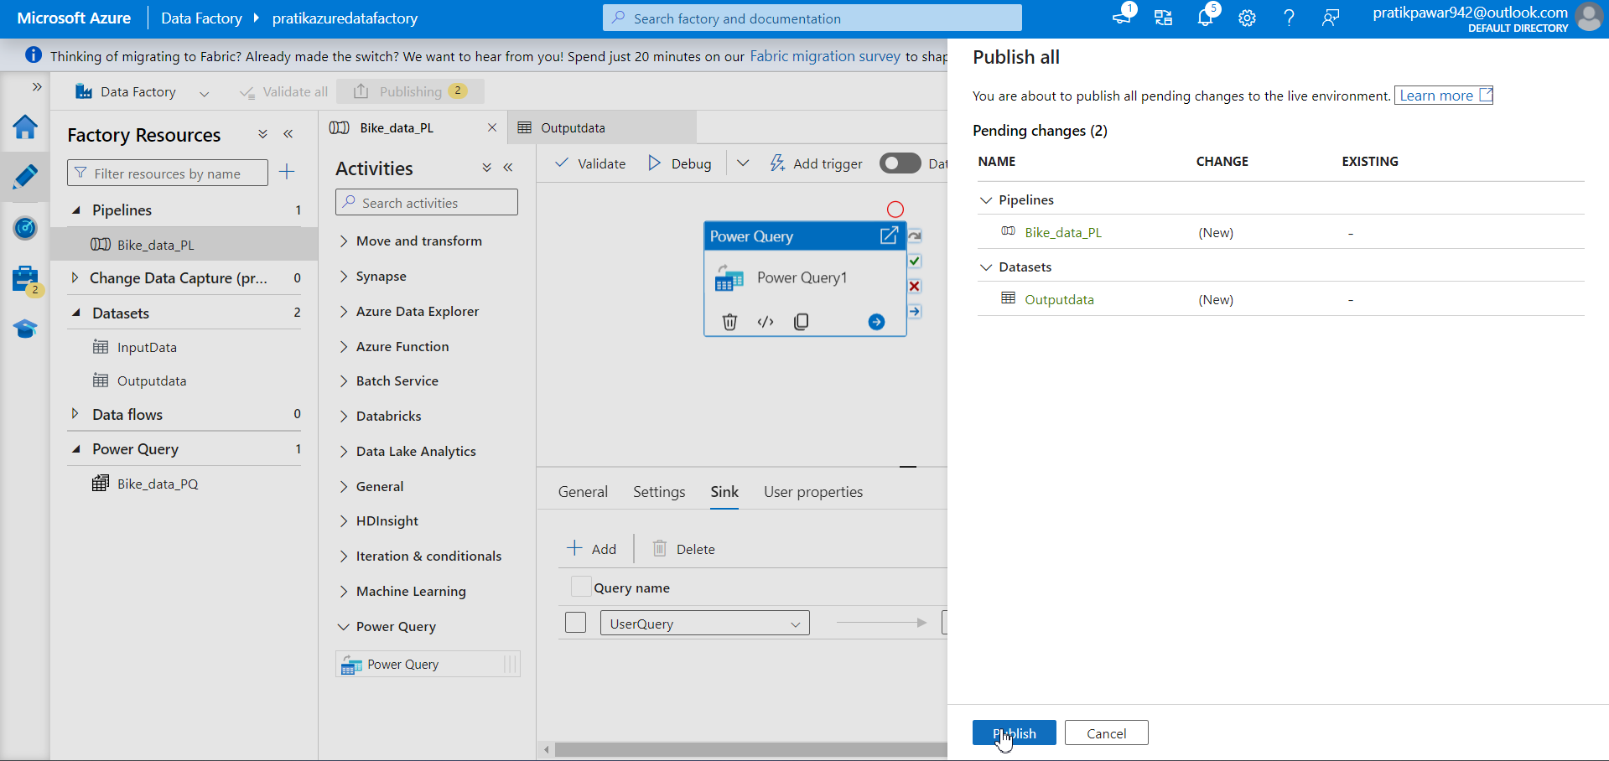
Publish

Slide 54
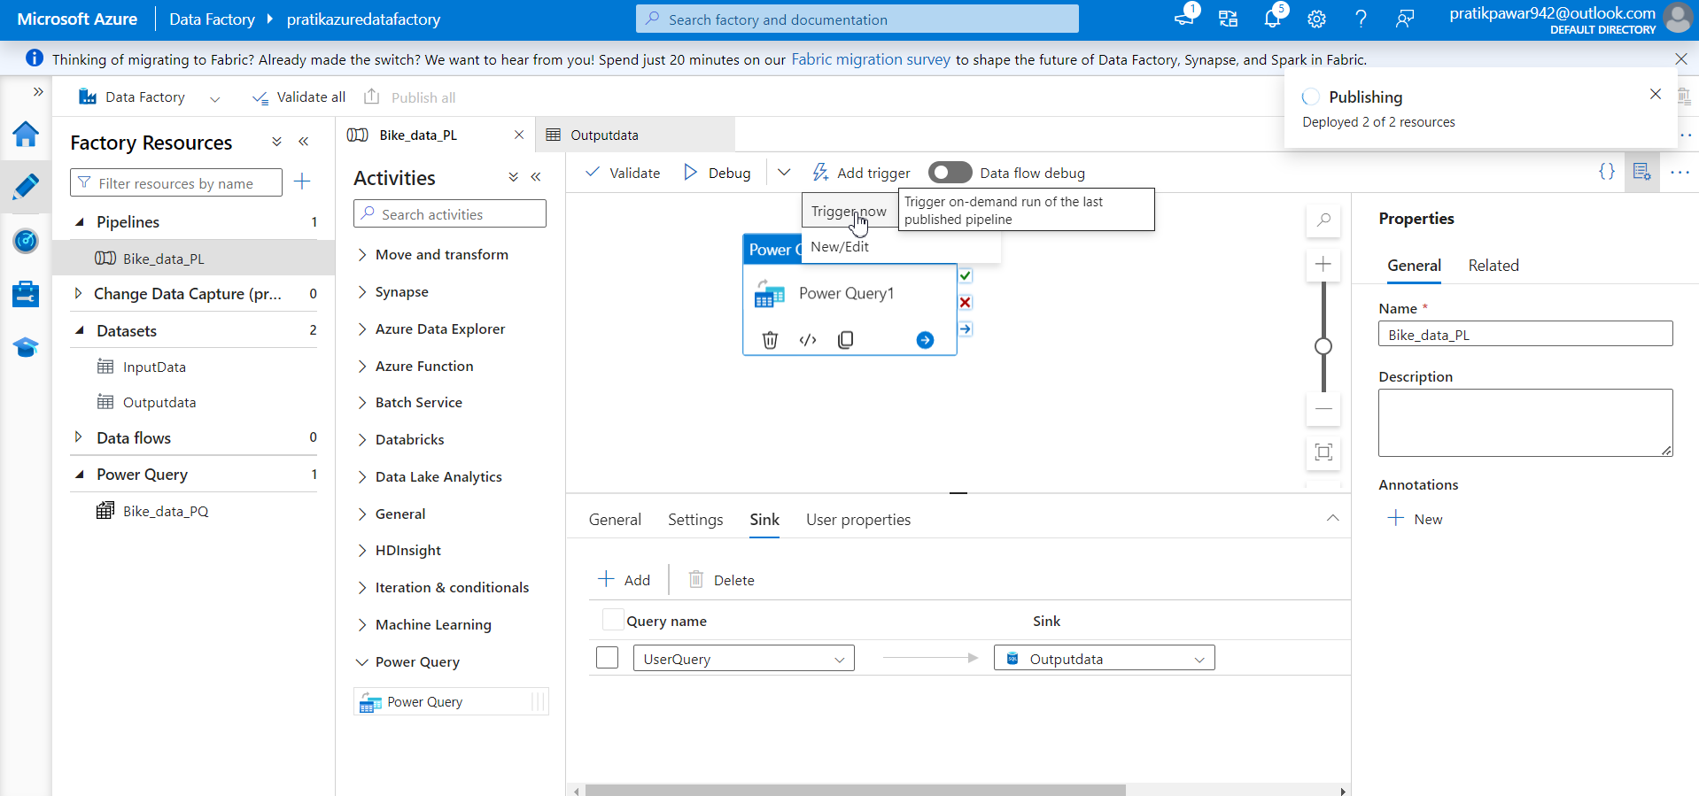
Add trigger → trigger now

Slide 55
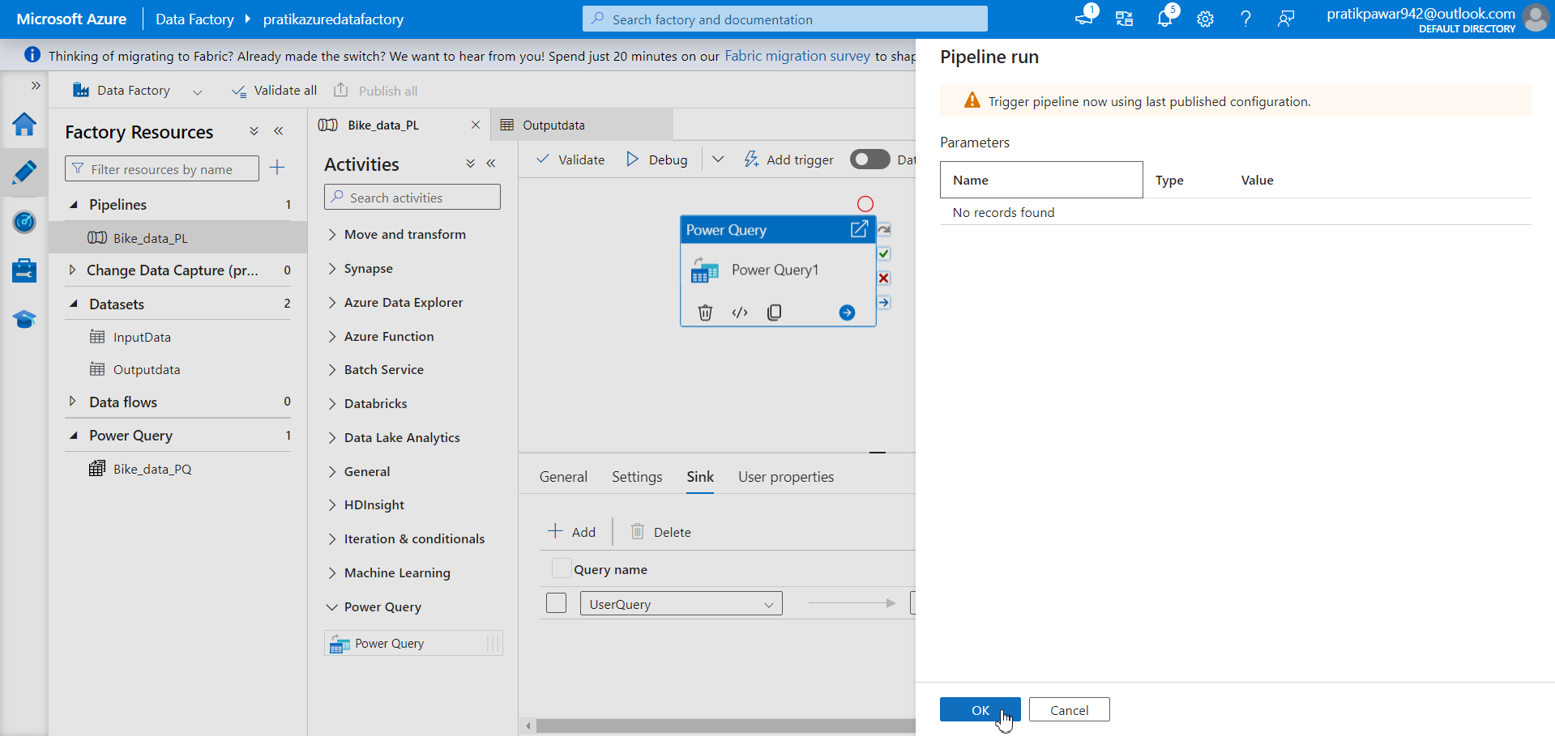
OK

Slide 56
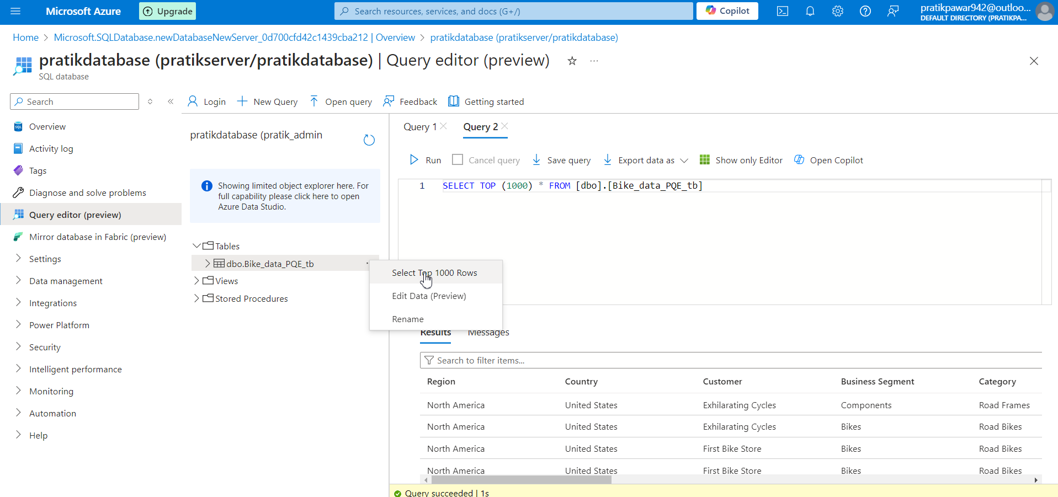
Finally Pipeline is successfully completed

